Slide 1
Spatial and temporal variation in natural organic matter quantity and quality across a second growth forested drinking water supply area on Vancouver Island, BC
practice presentation
Hannah J. McSorley (almost a master of science)
October 27, 2020

Slide 2
Presentation Overview
Background: forWater and Capital Regional District
Research questions, objectives and tasks
Study area and sub-basin sampling sites
Methods
Key findings and interpretations
Conclusions and future directions
| 2

Slide 3
Background: for Water Network
Forest Mgmt.
Source Water Quality
Protection
Regeneration
Pre-emptive risk reduction
Gain insights about drinking source water treatability as it relates to forest management
Evaluate aspects of forest management impacts on DOC fluxes, DOM composition and turbidity
Inform a range of treatability scenarios and implications
NOM
Turbidity
Nutrients
Contaminants
Algae
Chlorinated DBP-FP
Impediments to effective treatment & disinfection
Treatability

Slide 4
Capital Regional District
Greater Victoria Water Supply Area: 205.49 km² of protected source catchment lands
Primary supply source:
Sooke Lake Watershed & Reservoir System
Secondary supply source:
Goldstream Watershed & Reservoir System and Council Watershed (supplemental source)
Future supplemental source:
96.28 km² of Leech River Watershed
acquired in 2007 & 2010 and protected from forest harvest and public access
Unfiltered source water is disinfected with UV light and free chlorine (primary disinfection)
and then with ammonia, to produce chloramine (secondary disinfection)

Slide 5
Aqueous Natural Organic Matter
Master variable in aquatic systems
Binding and transport of metals
Precursor for disinfection by-products following source water chlorination
Nutrient source for heterotrophs
Algae blooms
Biofouling
Increased oxidant demand during treatment
Aqueous NOM
Transport
DBP-FP
Nutrient source
Treatment challenges
Terrestrial sources
In-stream sources

Slide 6
Research Question 1
How does aqueous NOM quantity and quality vary through space and time across the Greater Victoria Water Supply Area, and what influence does seasonality have?
Objective 1: Design a sampling strategy to describe spatial and temporal patterns and variation of DOC concentrations and UV-Vis spectral properties of NOM characteristics.
| 6

Slide 7
Research Question 2
With respect to watershed characteristics (e.g. slope or land-cover) and hydroclimatic conditions (e.g. antecedent wetness), what are the primary drivers for changes in NOM quantity and quality in the Leech Water Supply Area
Objective 2: Explore relationships between water sample results of NOM quantity and quality to watershed characteristics and sampling conditions to identify explanatory variables
| 7

Slide 8
Research Question 3
What are the implications for watershed management and future drinking water supply?
Objective 3: Provide context of how results can be used to inform watershed management planning for wildfire reduction strategies and design of continued water quality monitoring for future inter-basin transfers.
| 8

Slide 9
Tasks
Site Selection
Method Development
Field Installations
Sample Collection + Analysis
Data Analysis + Interpretation

Slide 10
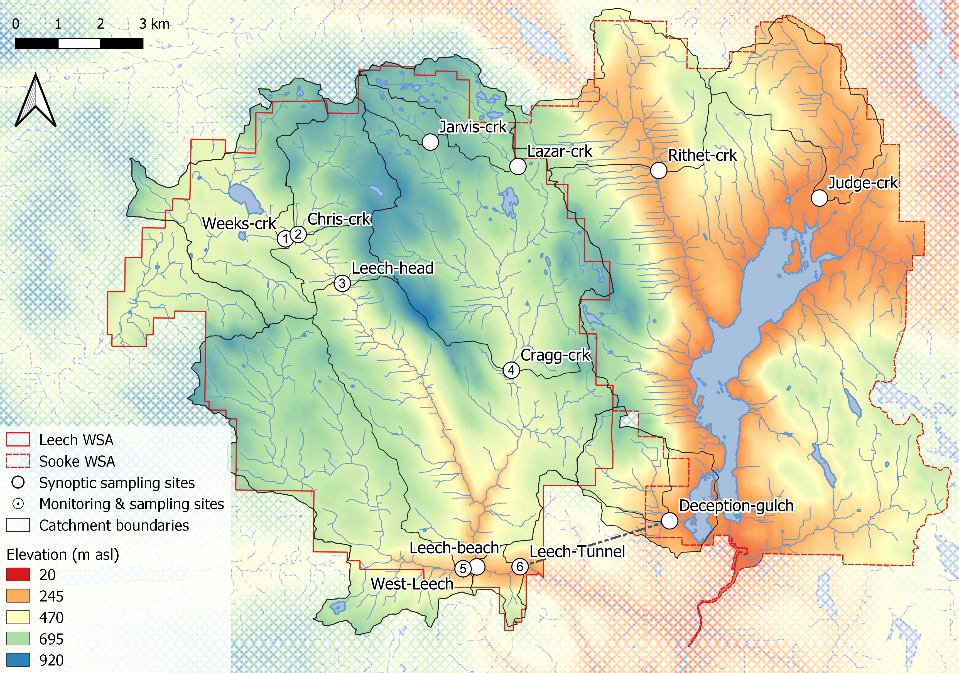
Synoptic Sampling Sites

Slide 11
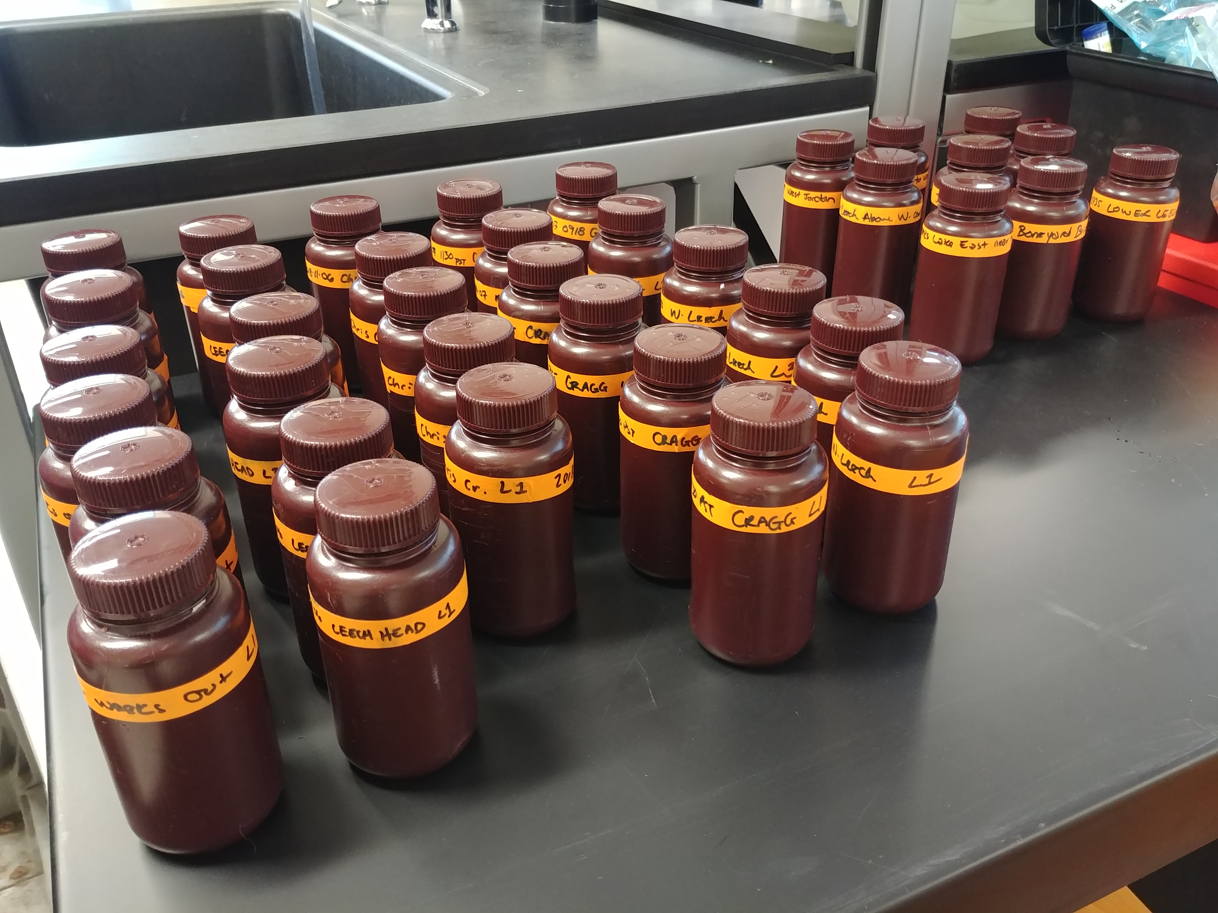
Synoptic Sampling Methods
Every 2-4 weeks
12 sites sampled over a 1- to 2-day period
Samples collected manually in acid-washed triple-rinsed 250 mL HDPE bottles
Transported on ice
Analyzed at UBC
DOC measured as proxy for NOM quantity (n = 387)
UV-Vis spectra for NOM quality assessment (n = 256)

Slide 12
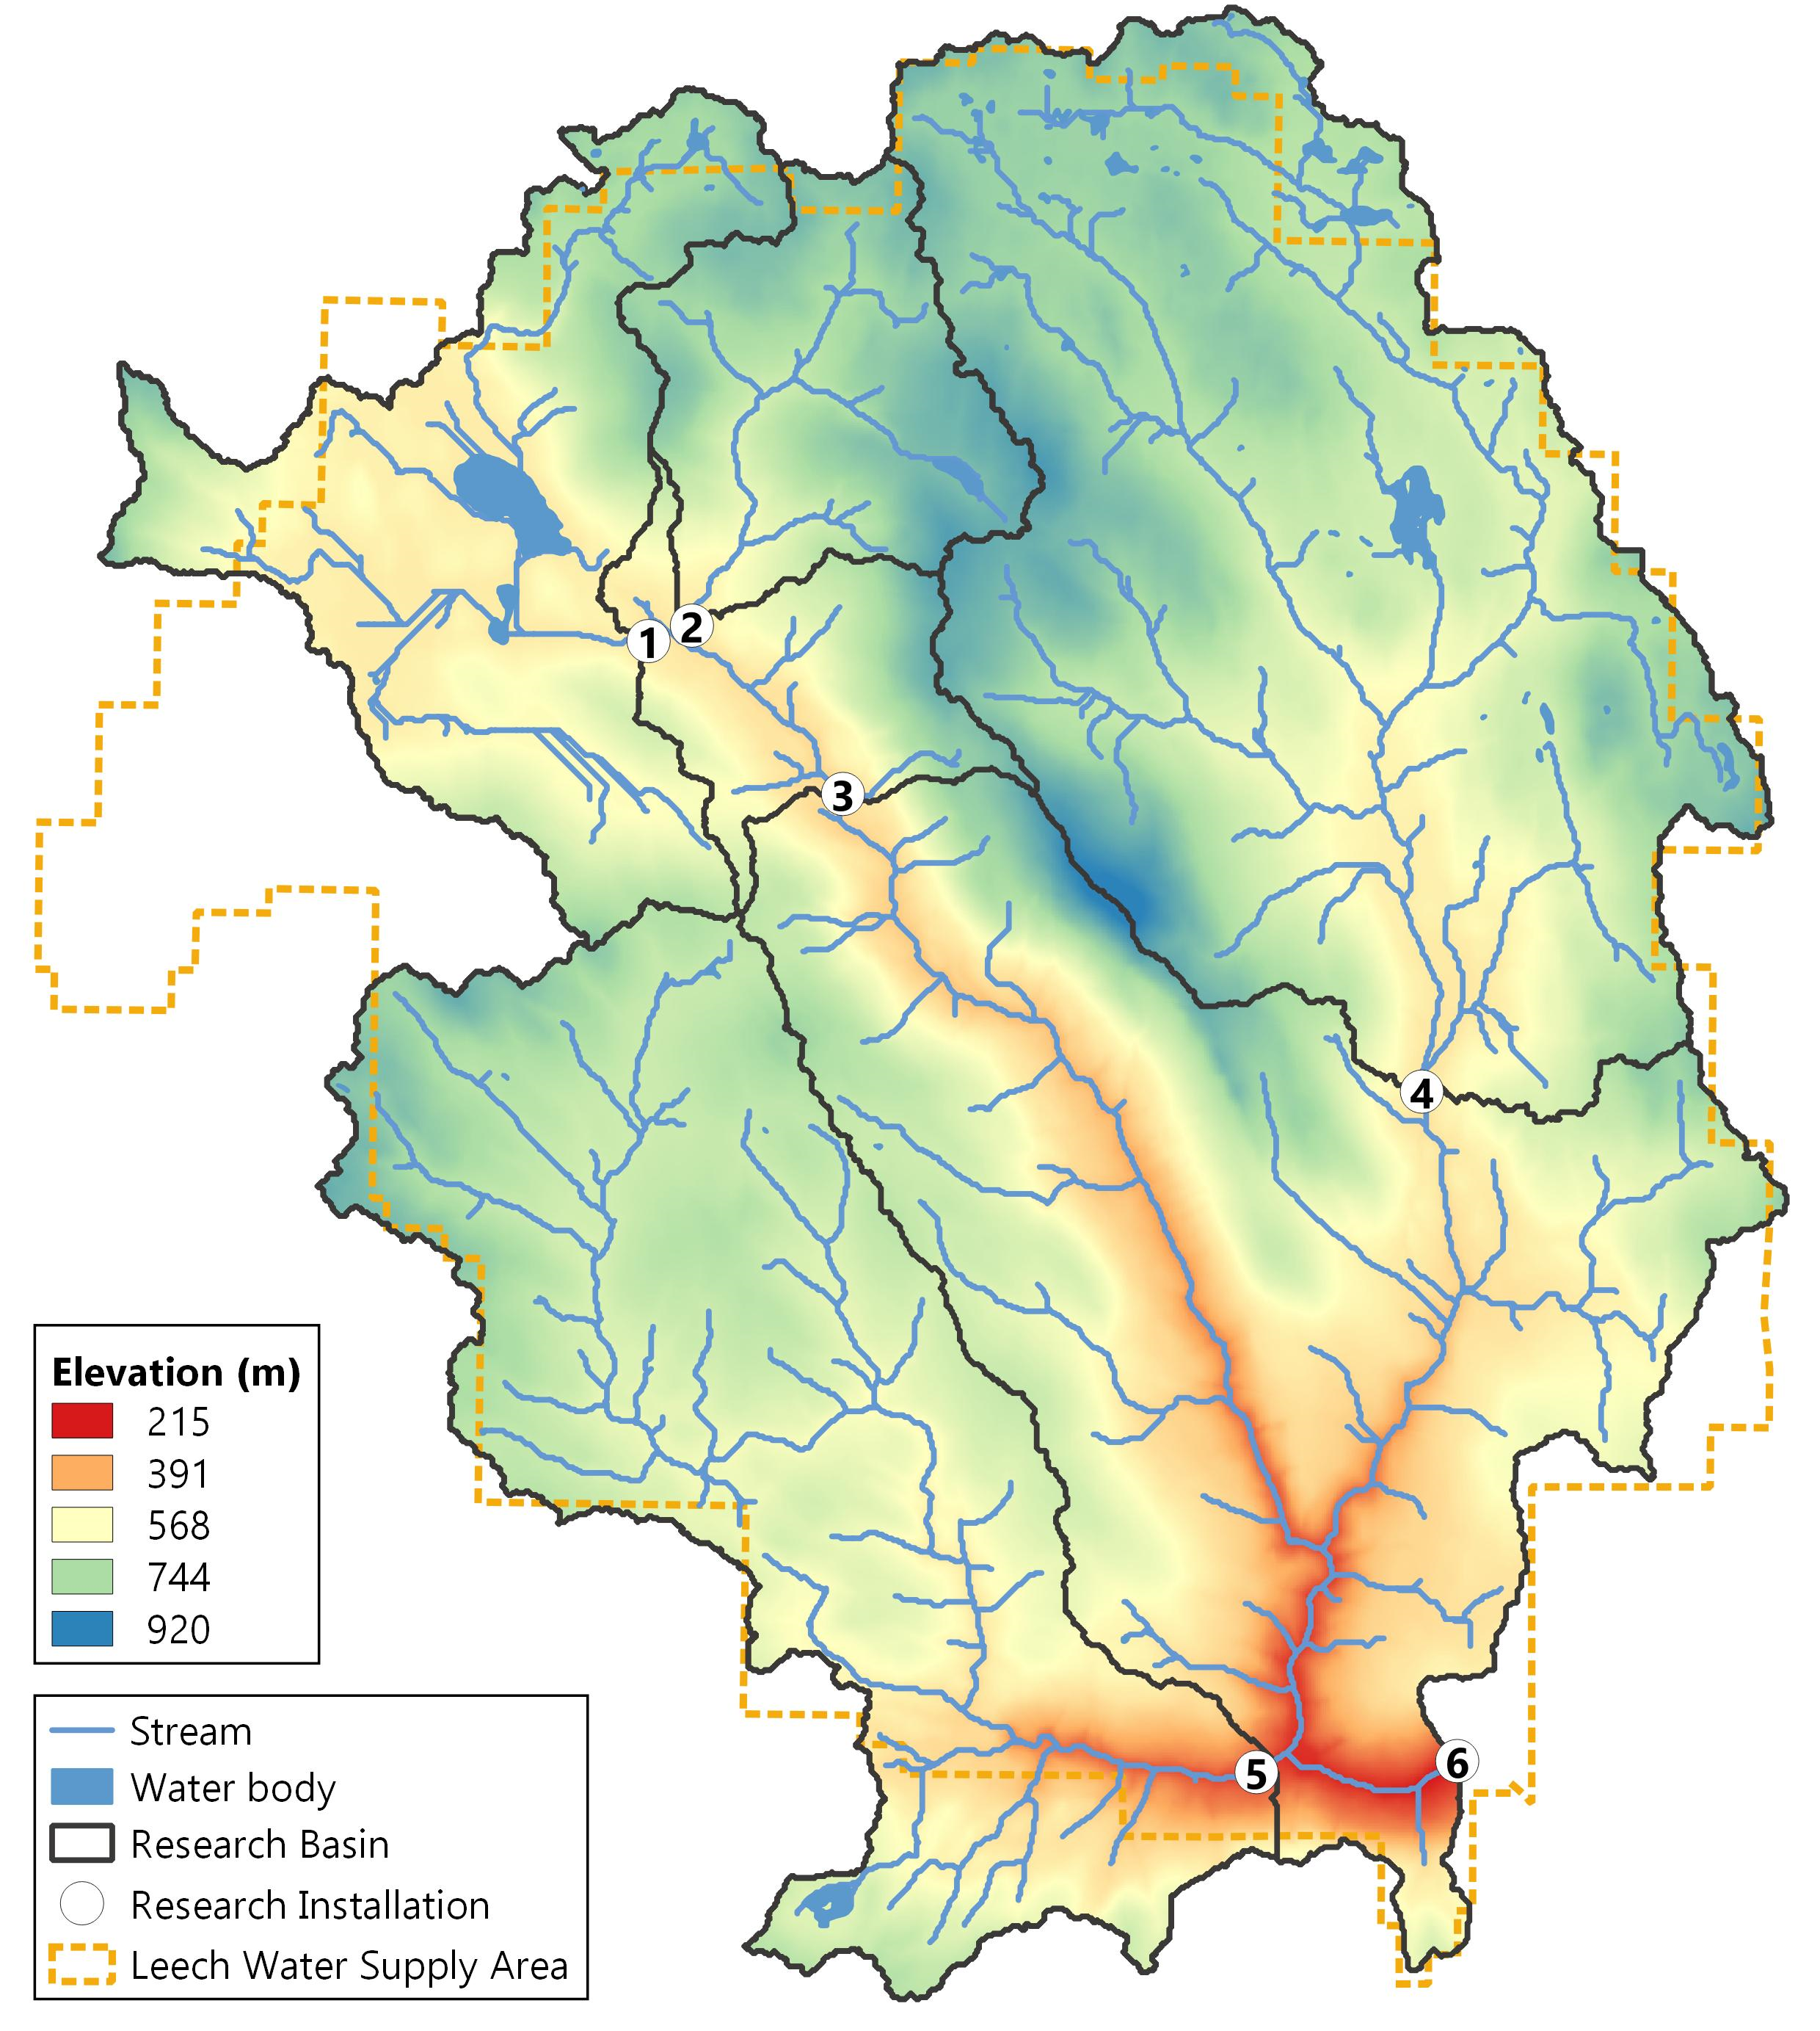
Monitoring Sites, Leech WSA
Weeks Main Creek
~16 km² drainage area
Chris Creek
~9.6 km²
Leech River Head
~ 26 km²
Cragg Creek
~ 37 km²
West Leech River
~ 35 km²
Leech River Tunnel
~ 98 km²
2
1
3
4
5
6

Slide 13
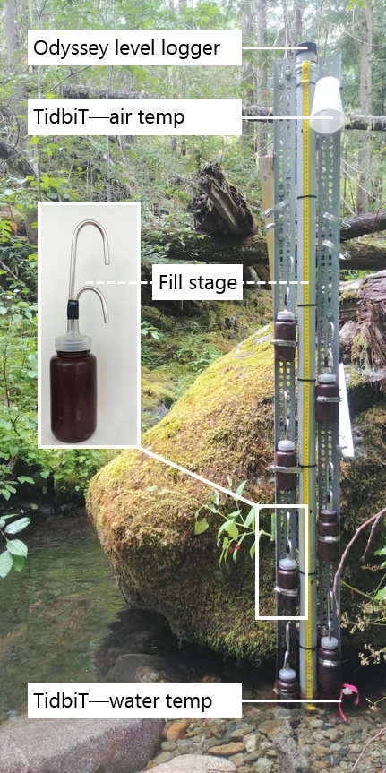
Monitoring Methods: Vertical Rack Sampling
Central stilling well with water level logger
Each sample bottle had a siphon lid
Based on USGS single stage sediment sampler design (US U-59, 1961)
Sampling bottles were generally staggered at 10-15 cm intervals
Each inlet crown was referenced to an external measurement on the stilling well
Bottle heights were referenced to recorded stage
corresponding date-time of sample collection was retrieved

Slide 14
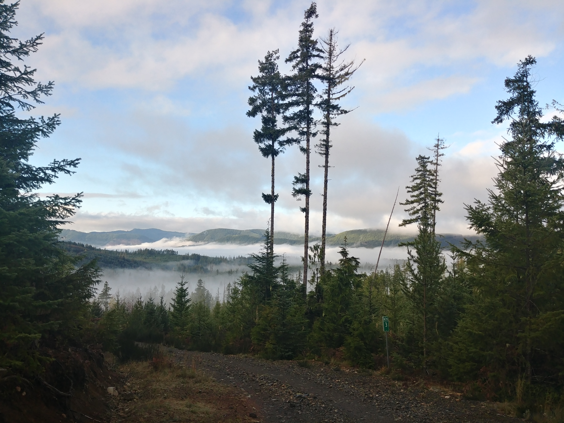
Foundational Results
Seasons were defined by the period in which stormflow samples were collected by vertical racks
SAC₂₅₄ was better correlated to DBP-FP than SUVA₂₅₄
Rack samples were stable in the field for up to 20 days at an average of 6° C

Slide 15
Key Findings (RQ 1)
Spatial patterns:
Lower order streams (i.e. headwaters) had higher concentrations of DOC with more aromatic and reactive character than higher order streams
Streams draining the west of Leech WSA had higher concs with more aromatic character than those draining from the east
Temporal patterns:
Reduction in aqueous NOM quantity from early in the wet season to later in the wet season
~80% of the time, maximum DOC conc was found in the highest stage samples (i.e. peak flow tended to carry peak DOC)
Seasonal patterns:
Average DOC conc was the same in the wet and dry seasons (6.14 mg/L)
Shift in character from autochthonous (aliphatic) to allochthonous (aromatic)
| 15

Slide 16
Key Findings (RQ 2)
Spatial patterns:
Lower order streams (i.e. headwaters) had higher concentrations of DOC with more aromatic and reactive character than higher order streams
Streams draining the west of Leech WSA had higher concs with more aromatic character than those draining from the east
Temporal patterns:
Reduction in aqueous NOM quantity from early in the wet season to later in the wet season (dilution effects and/or temperature effects)
~80% of the time, maximum DOC conc was found in the highest stage samples (i.e. peak flow tended to carry peak DOC)
Seasonal patterns:
Average DOC conc was the same in the wet and dry seasons (6.14 mg/L)
Shift in character from autochthonous (aliphatic) to allochthonous (aromatic)
| 16

Slide 17
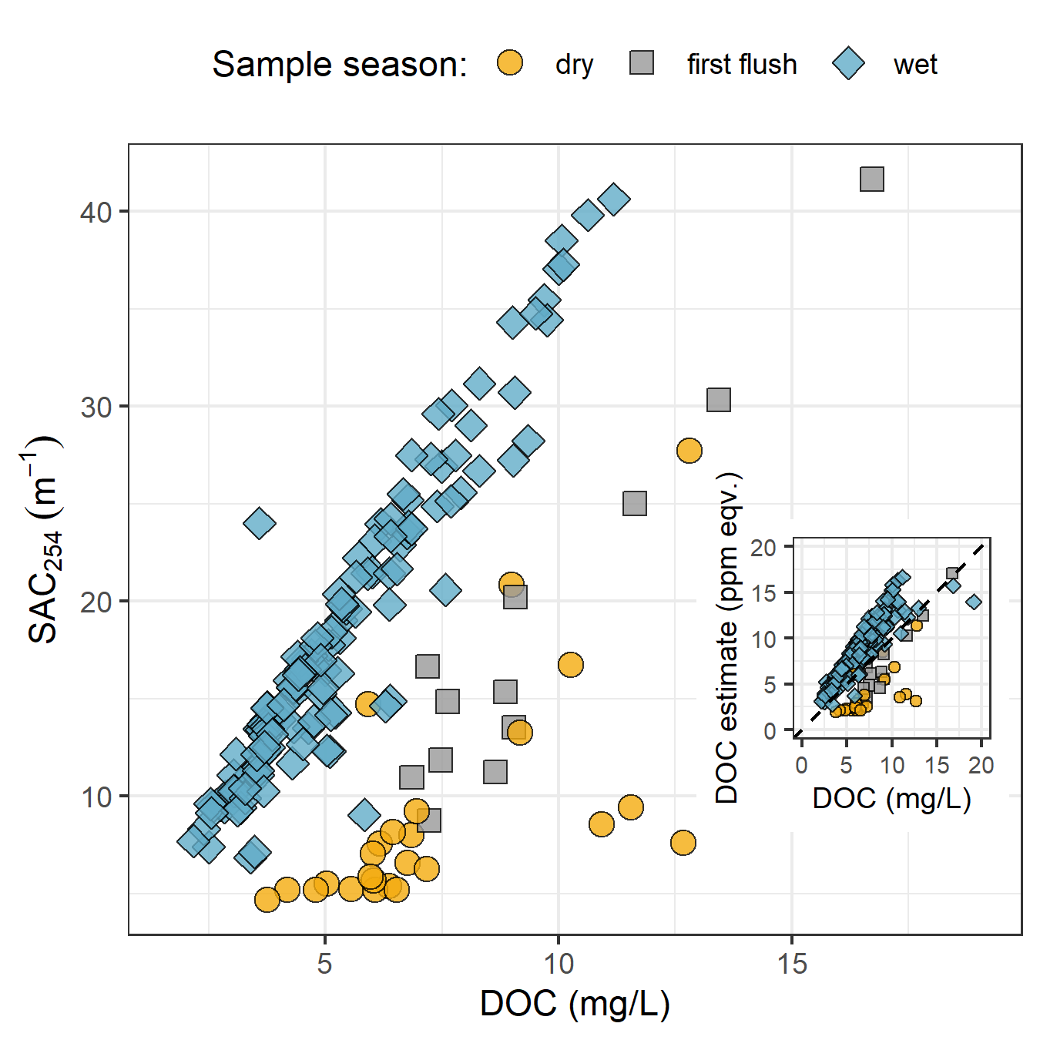
Seasonal Shift in Quality
DOC correlated with SAC₂₅₄
wet season (R² = 0.896, n = 149)
transition from dry to wet seasons (first-flush event, R² = 0.916, n = 14),
dry season (R² = 0.396, n = 25).
Indicates a shift in NOM source pools between seasons,
Wet season = allochthonous (humic-like, aromatic) sources
Dry season = autochthonous (biolabile algal-derived, aliphatic) sources dominating in the dry season

Slide 18
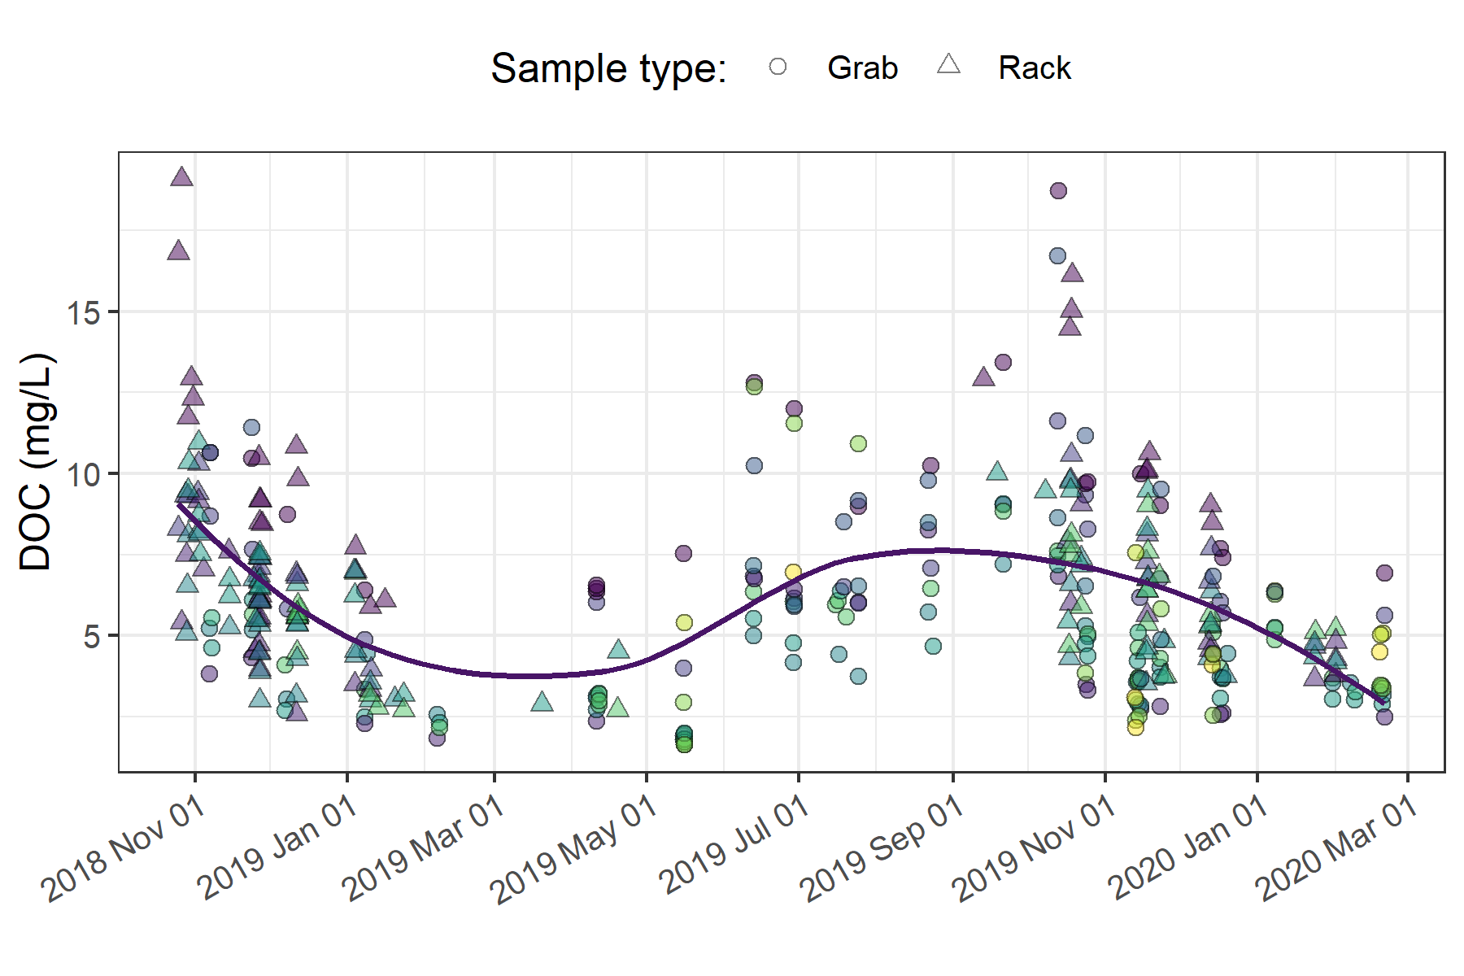
Temporal Pattern in DOC
Seasonal dilution
Lowest DOC during snow/freeze period (also few samples collected

Slide 19
Aqueous Metals
Grab samples were collected on behalf of CRD IWS for a suite of metals analysis at Maxxam Analytical Lab
Natural organic matter has the ability to bind and transport metals in solution.
| 19

Slide 20
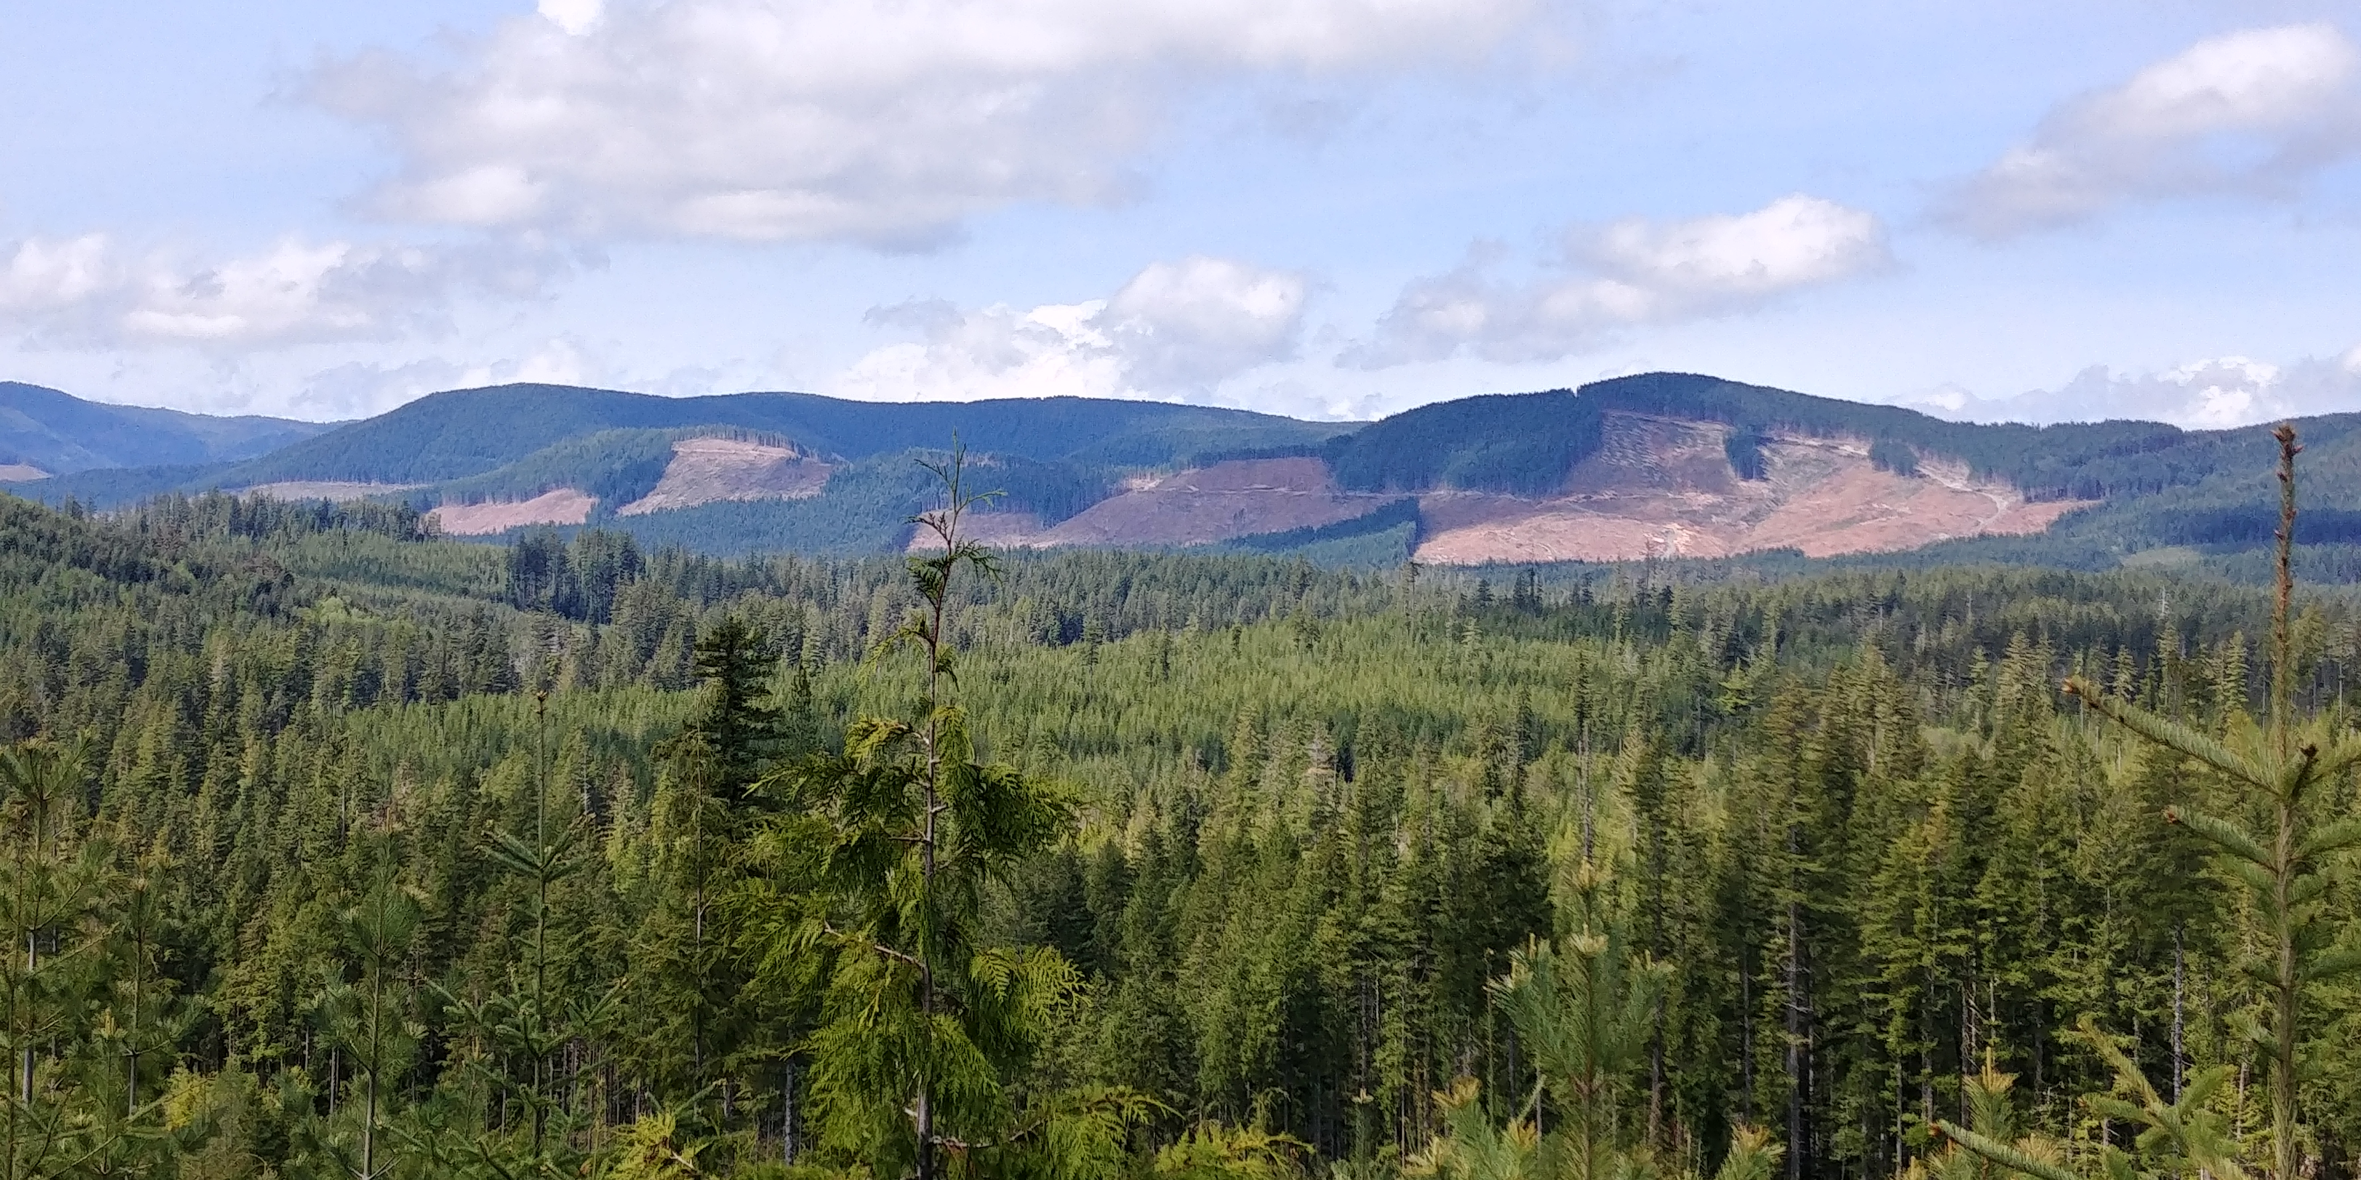
Adjacent Harvest
Harvest west of Jordan Meadows and Weeks Lake
Partly within the Leech River watershed
Closest monitoring site is Jordan Meadows Outlet (Site 1)
Hypothesis: protected wetlands will reduce impact of harvest on water quality, negligible change will be observed at Site 1

Slide 21
Planning
MSc Completion April 30, 2020
Build a more robust set of results
Continue field work and data collection until Feb / Mar 2020
Bi-weekly to monthly site visits
Improve strategies for optimal sampling
Falling limb sampler prototype
Monitor temperature (continuous), pH + conductivity (portable)
Hold-time experiments
Take advantage of forWater treatability analyses (now available)
| 21

Slide 22

forWater Treatability Analyses
Leveraging “economies of scale” to conduct treatability analyses
Ensure consistency in analytical approaches
Draw broad network‐wide conclusions
Treatability metrics:
Characterize natural organic matter
Disinfection by-product formation potential
Colloid charge & treatment demand
Classify algae & cyanobacteria
Source Water Treatability Analyses
NOM Character
DBP-FP
Surface Properties
Algae

Slide 23
Treatability Analysis: Algae
Taxonomic classification of Algae & Cyanobacteria
Confirm the presence of genes associated with the production of cyanotoxins (not necessarily the expression of those genes)
Dr. Kirsten Müller’s lab at University of Waterloo
Up to
over
5 sites
4 months
Taste & odour problems
June-Sept
2
samples per month per site
Cyanotoxins (e.g. anatoxin,
microcystin)
Cyanobacteria
& Algae
Fouling, interference & service disruptions

Slide 24
Planning: Summer 2019
Field
Bi-weekly sampling for low-flows, metals, algae + treatability
Addition of temperature sensors to installations
Deploy Philips samplers (fine suspended sediment)
Experimental Design Suggestions
Weeks Lake + Sooke Reservoir Comparison
Treatability analyses, especially algae & cyanobacteria
Mixing study of Leech with Sooke
Assess differences in source water treatability
| 24

Slide 25
Planning: Summer 2019
Field
Bi-weekly sampling for low-flows, metals, algae + treatability metrics
Addition of temperature sensors to installations
Deploy Philips samplers (fine suspended sediment)
Experimental Design Suggestions
Weeks Lake + Sooke Reservoir Comparison
Treatability analyses
Algae & cyanobacteria
Mixing study of Leech with Sooke
Combined source water treatability

Slide 26
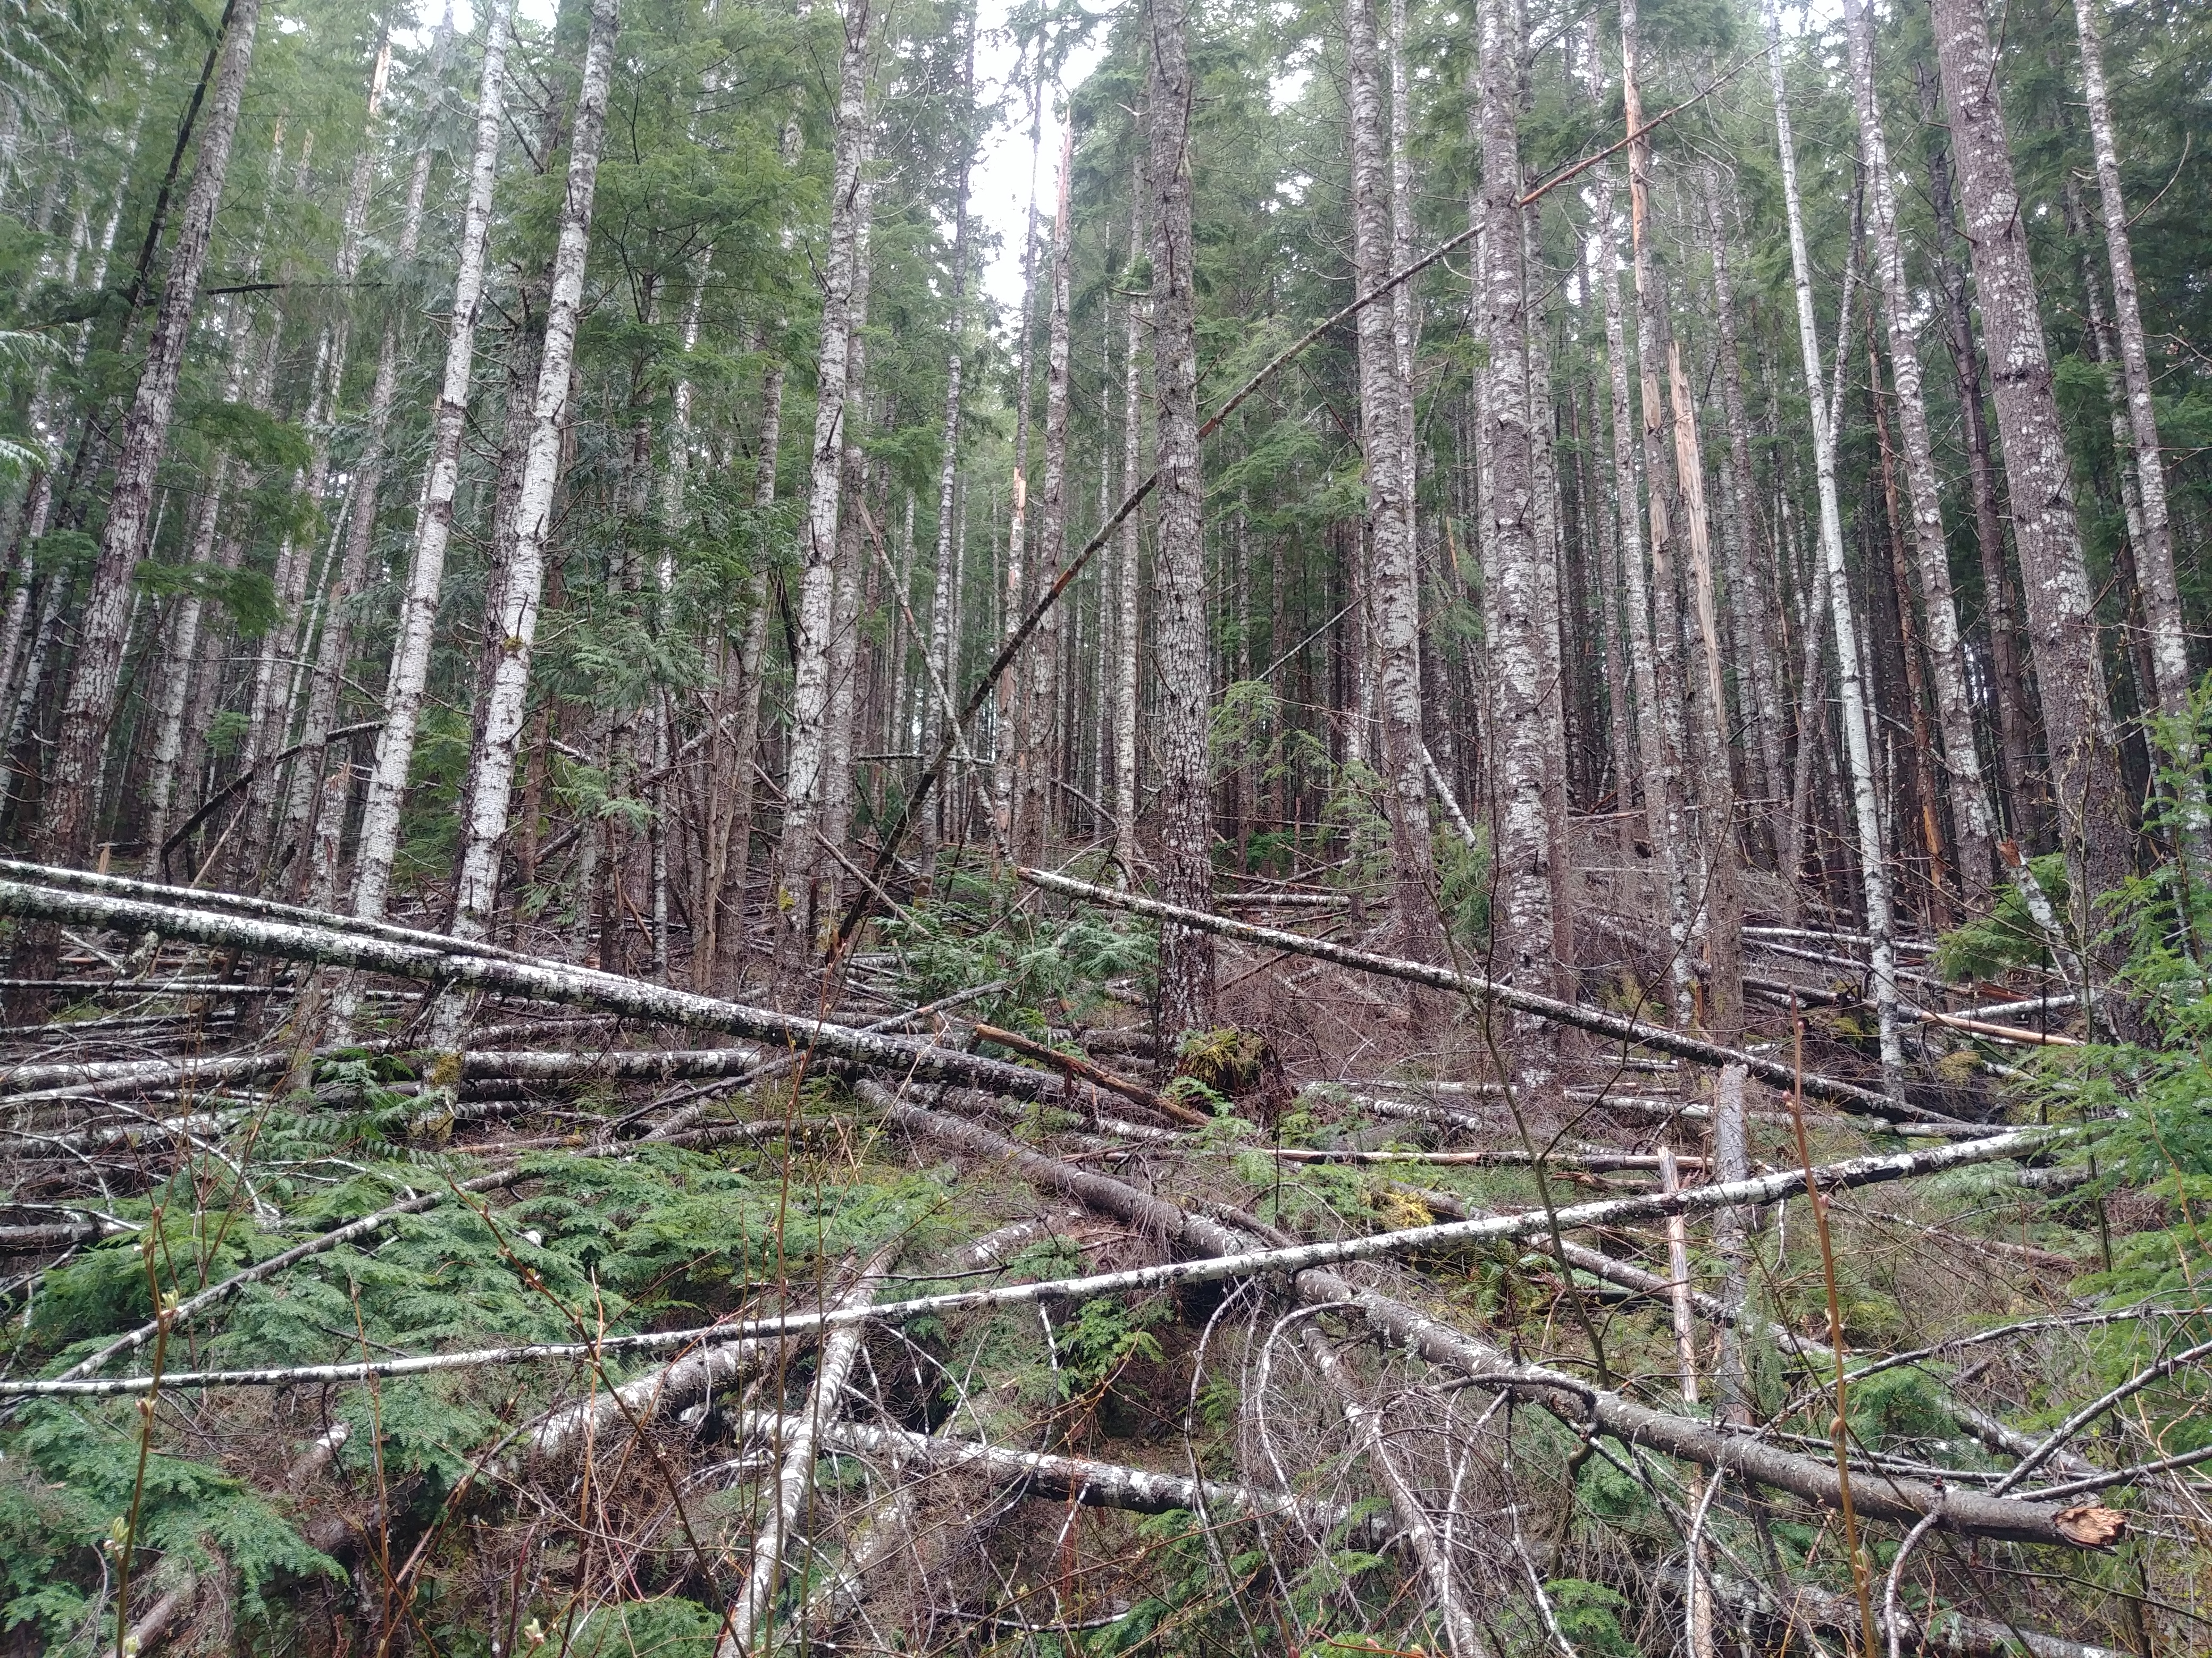
Planning: Experimental Connections
Forest Treatment
Fire Fuel Management
Prescribed burn in the Leech?
Water quality above + below or before + after
Culvert replacement (Weeks Main)

Slide 27
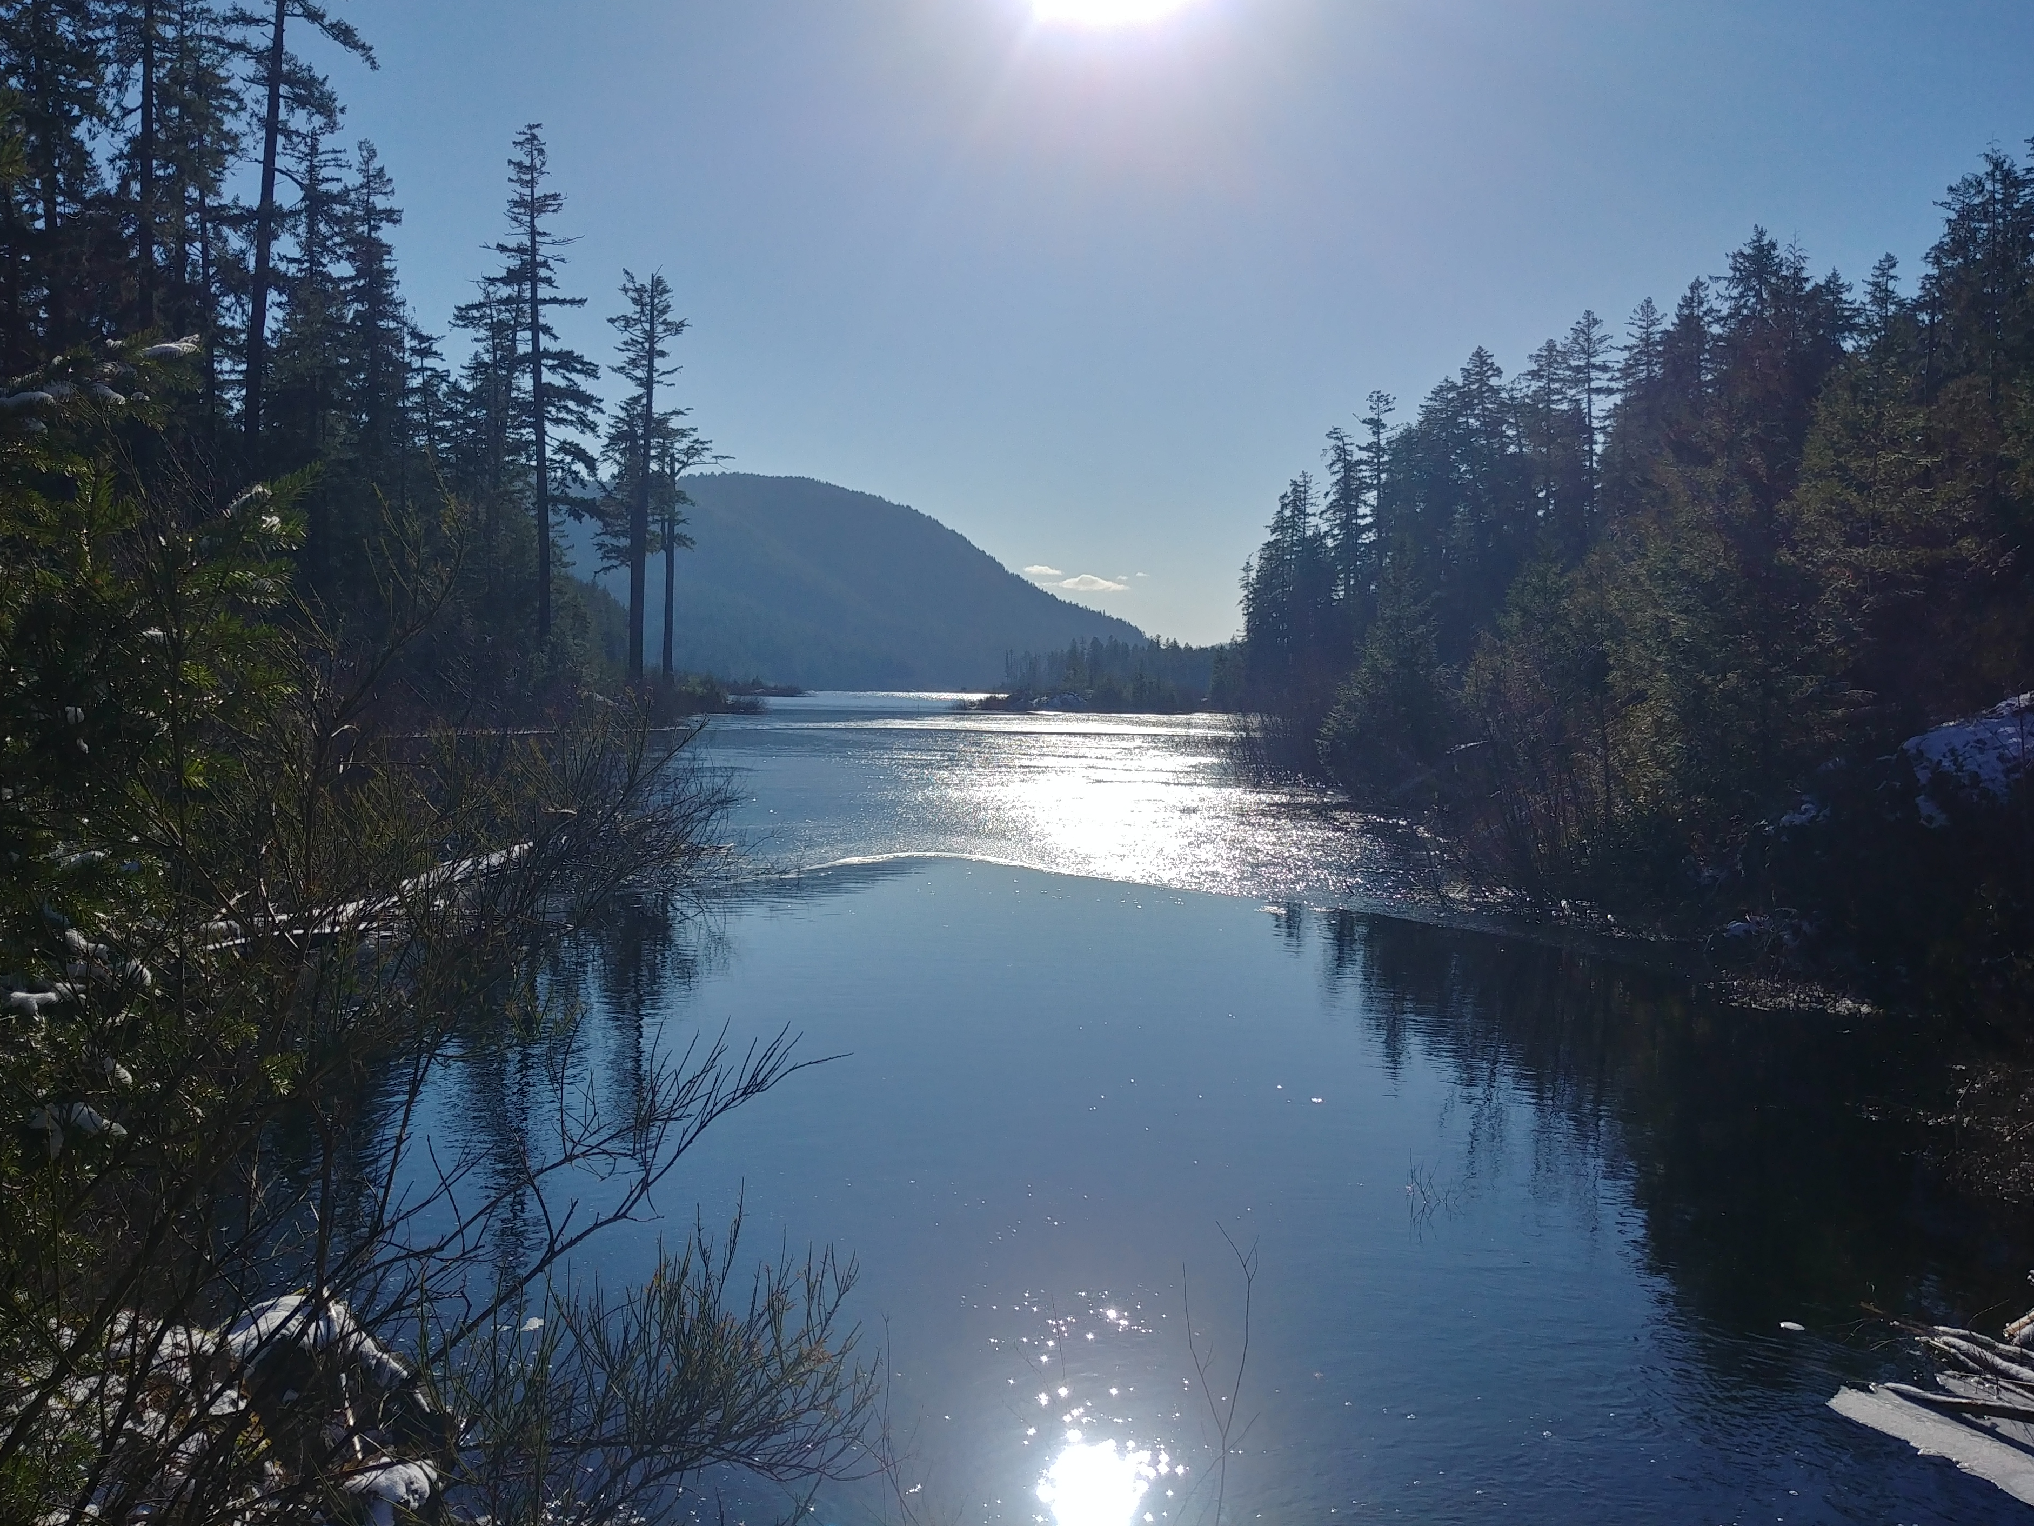
Planning: Experimental Connections
Drinking Water Treatment
GVWSA Water Treatment
Is there someone in water treatment that I can talk with about treatment demands and challenges?

Slide 28
Thank you! hjmcsorley@gmail.com 1-250-755-6062

Slide 30
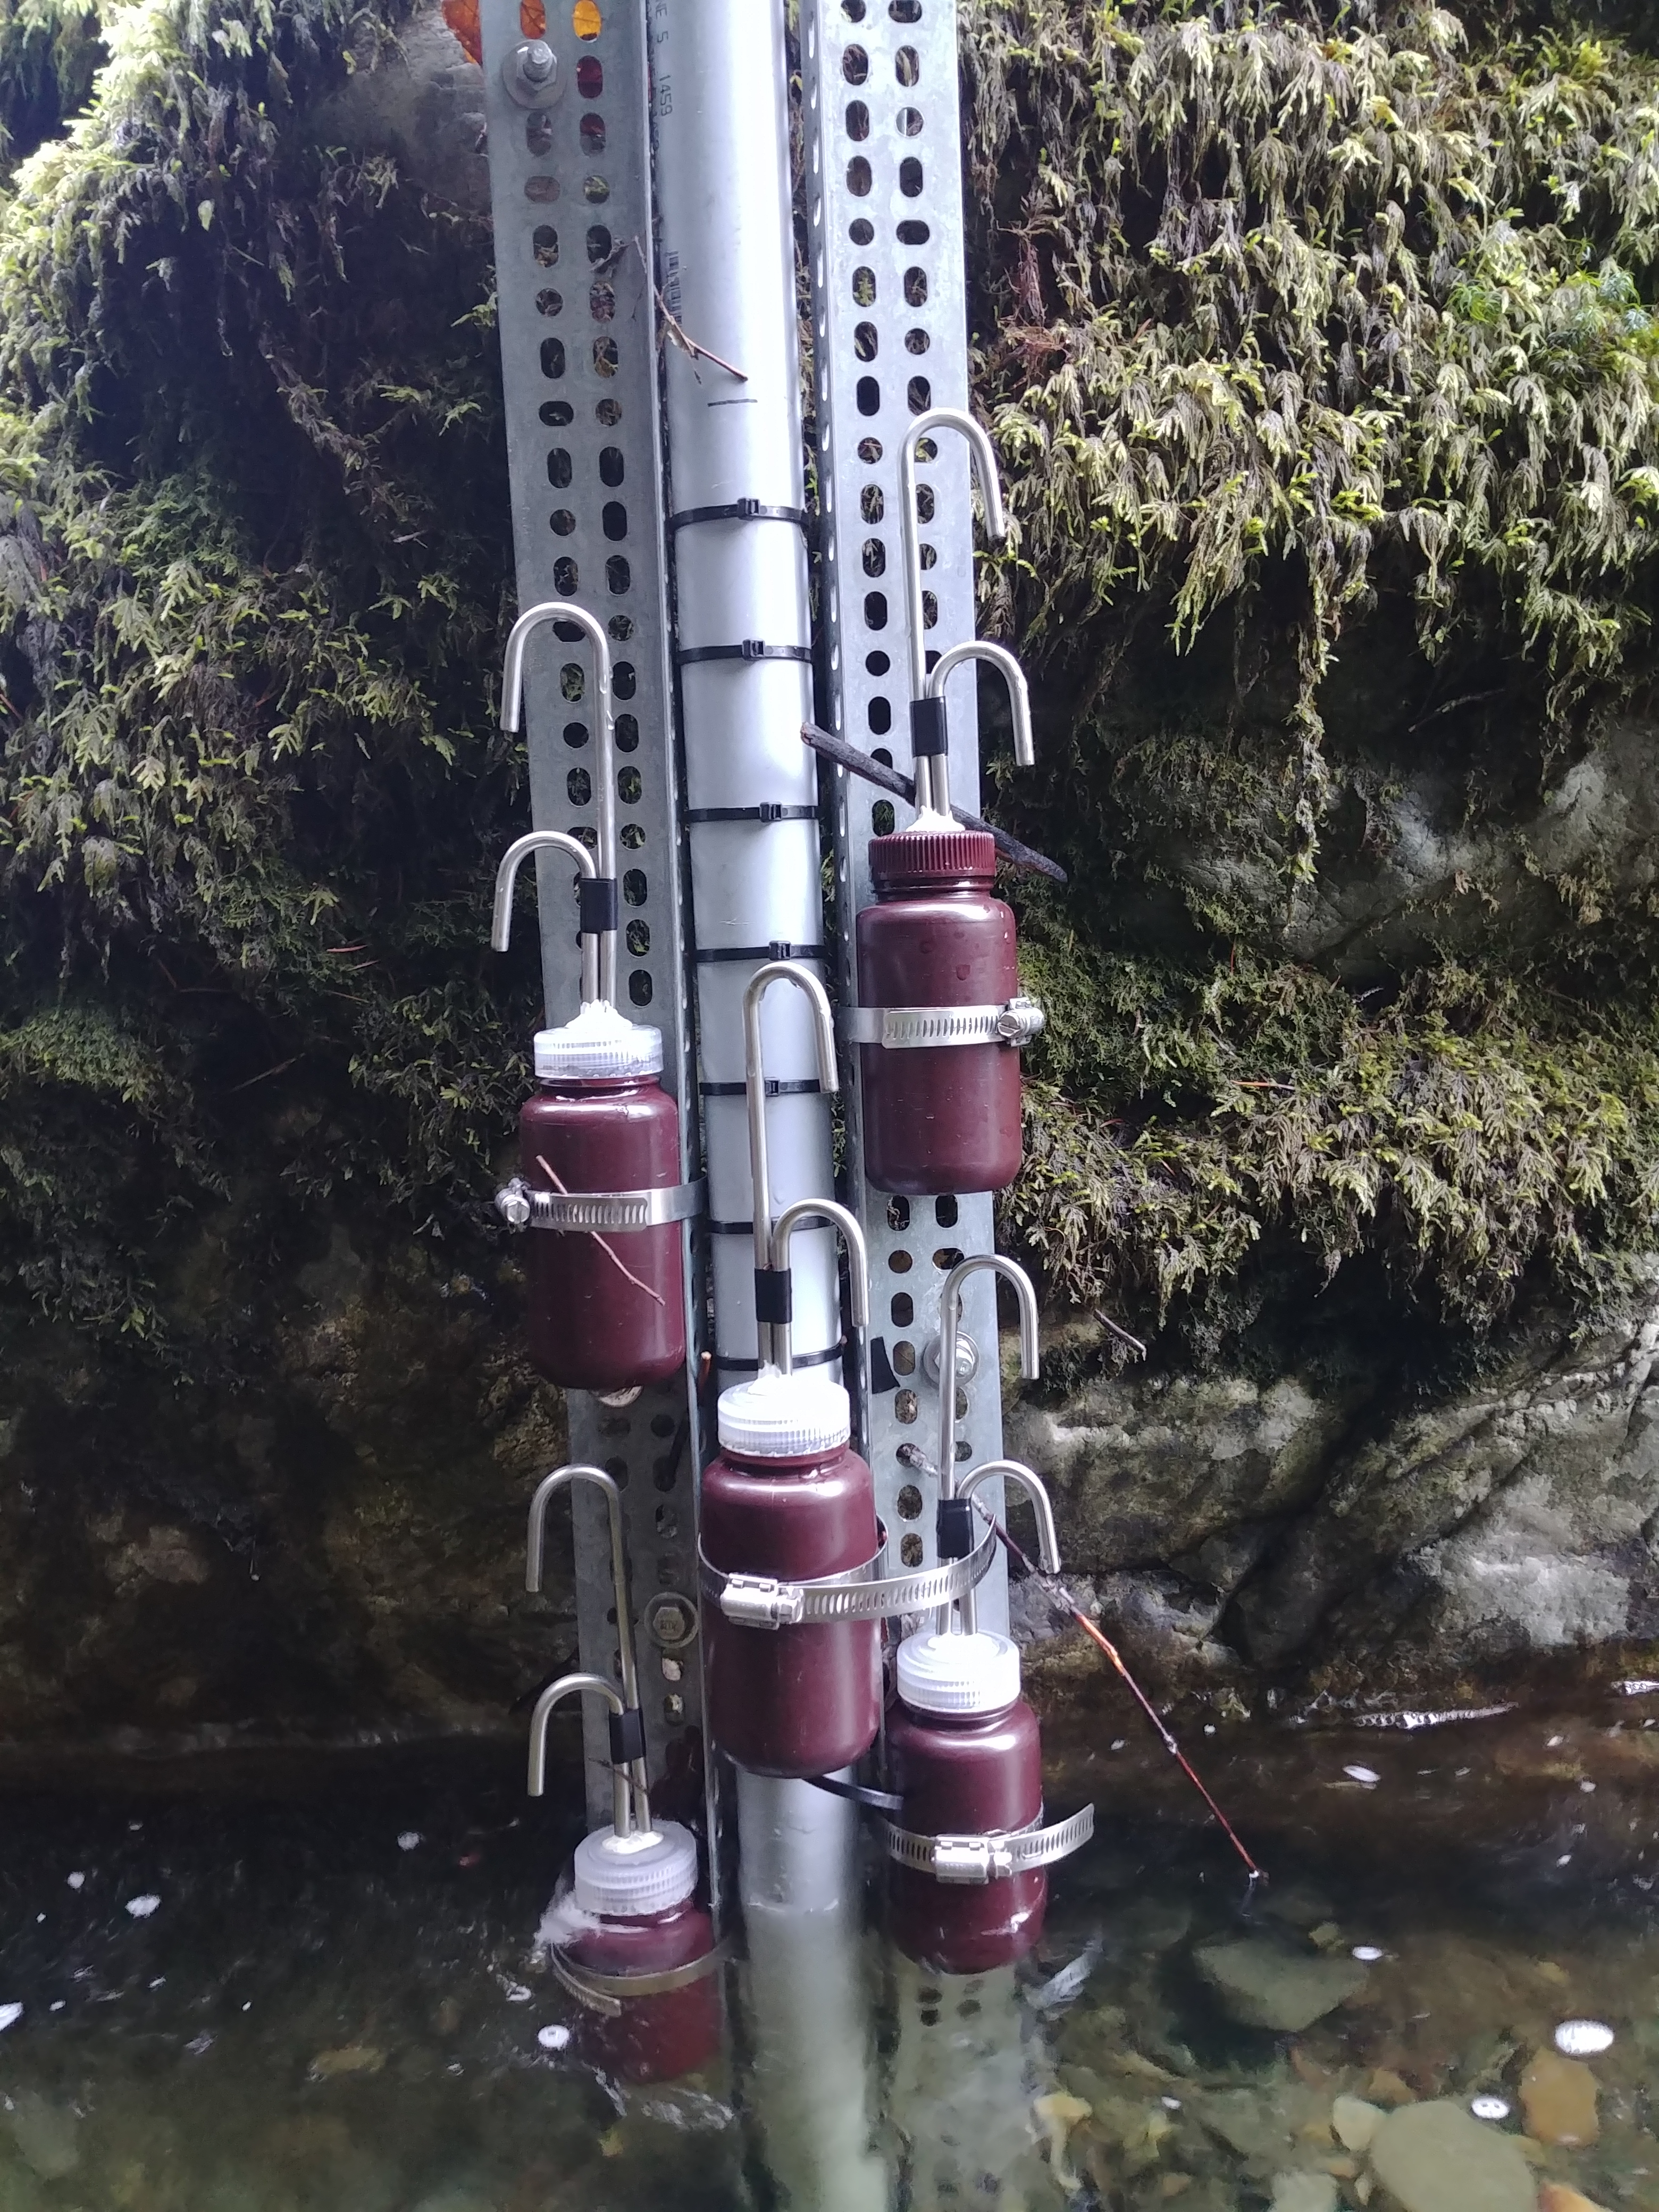
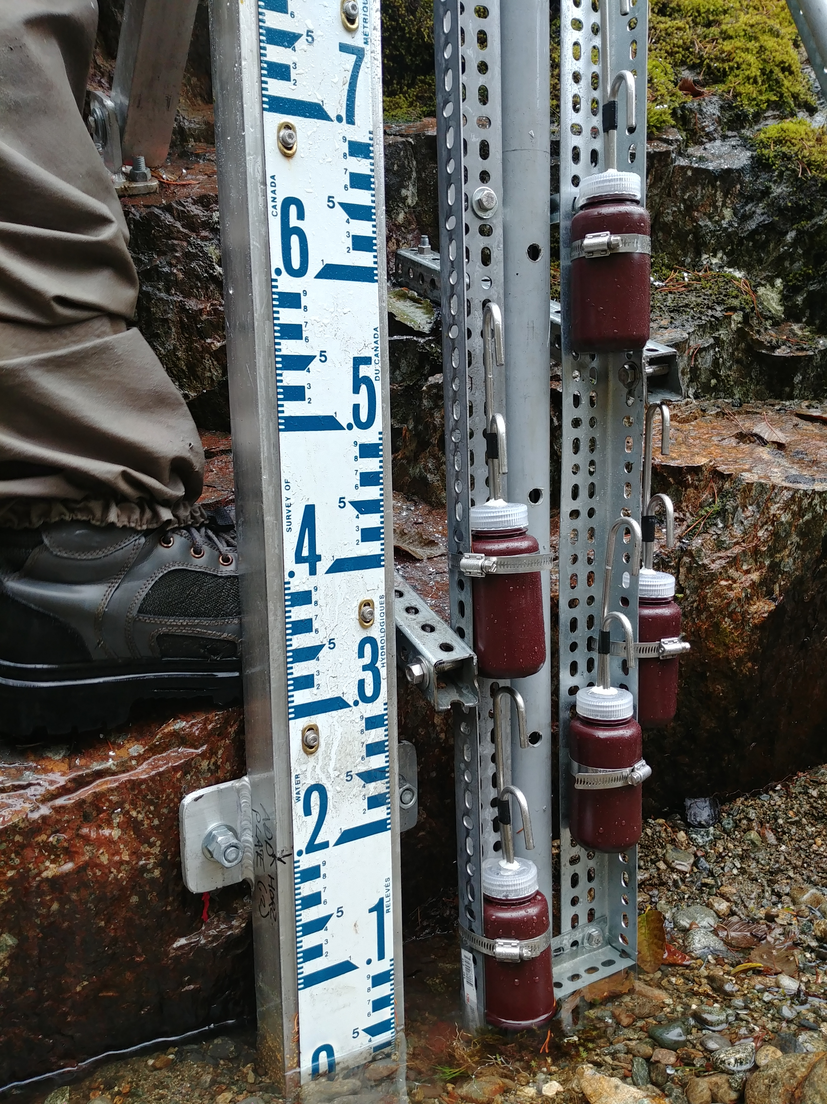
Extended Method: Rack Sampling
Central stilling well contains water level logger
Each sample bottle has a siphon lid
Based on USGS single stage sediment sampler design (US U-59, 1961)
Sampling bottles can be placed at any height, generally staggered at 10-15 cm intervals
Each inlet crown is referenced to a external measurement on the stilling well
Bottle heights are referenced to recorded stage
corresponding date-time of sample collection is retrieved
Air vent
Sample Collection
Intake Crown
Inlet
WATER LEVEL RISE
Water Level

Slide 31
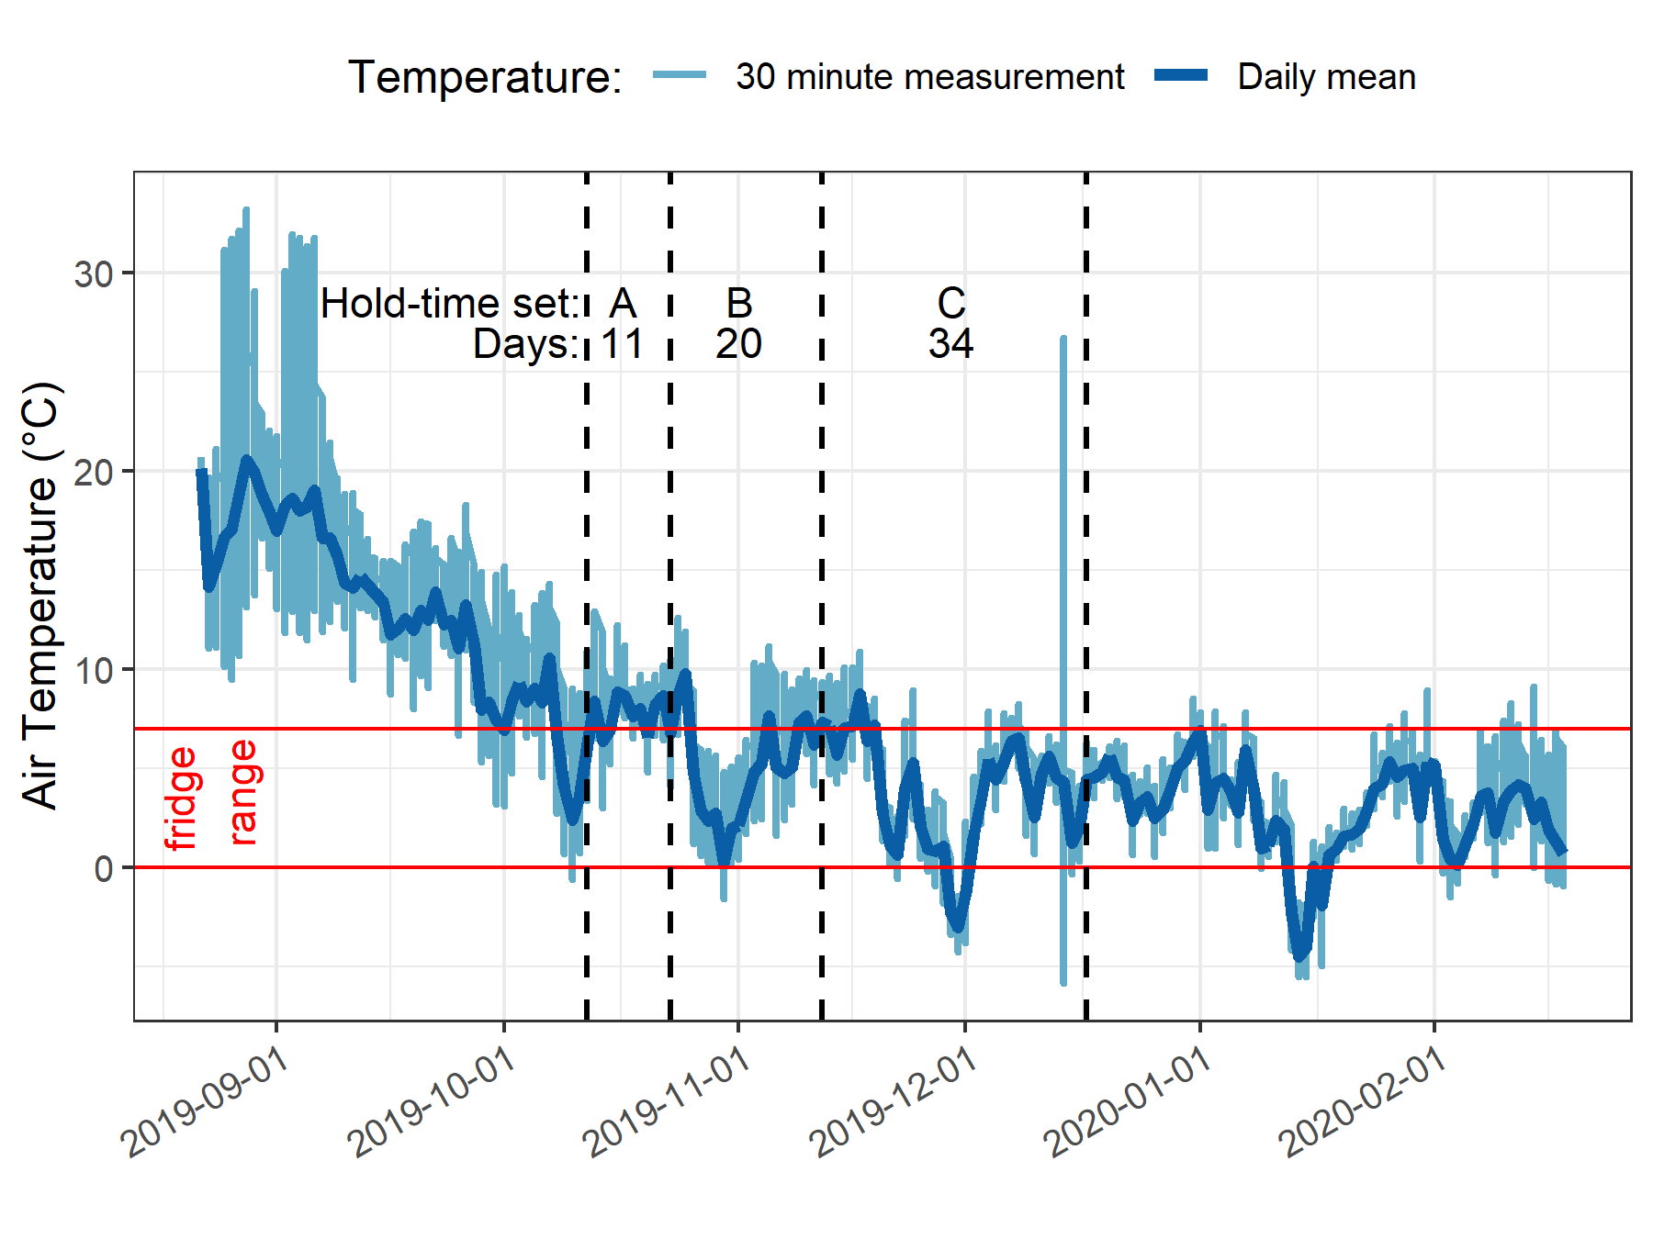
Rack Sample Hold-time Experiments
Three sets (A, B, C) of replicate samples collected (n=10)
5 were analyzed following collection (“fresh”)
5 were held on the vertical rack and analyzed after a hold-period (“held”)

Slide 32
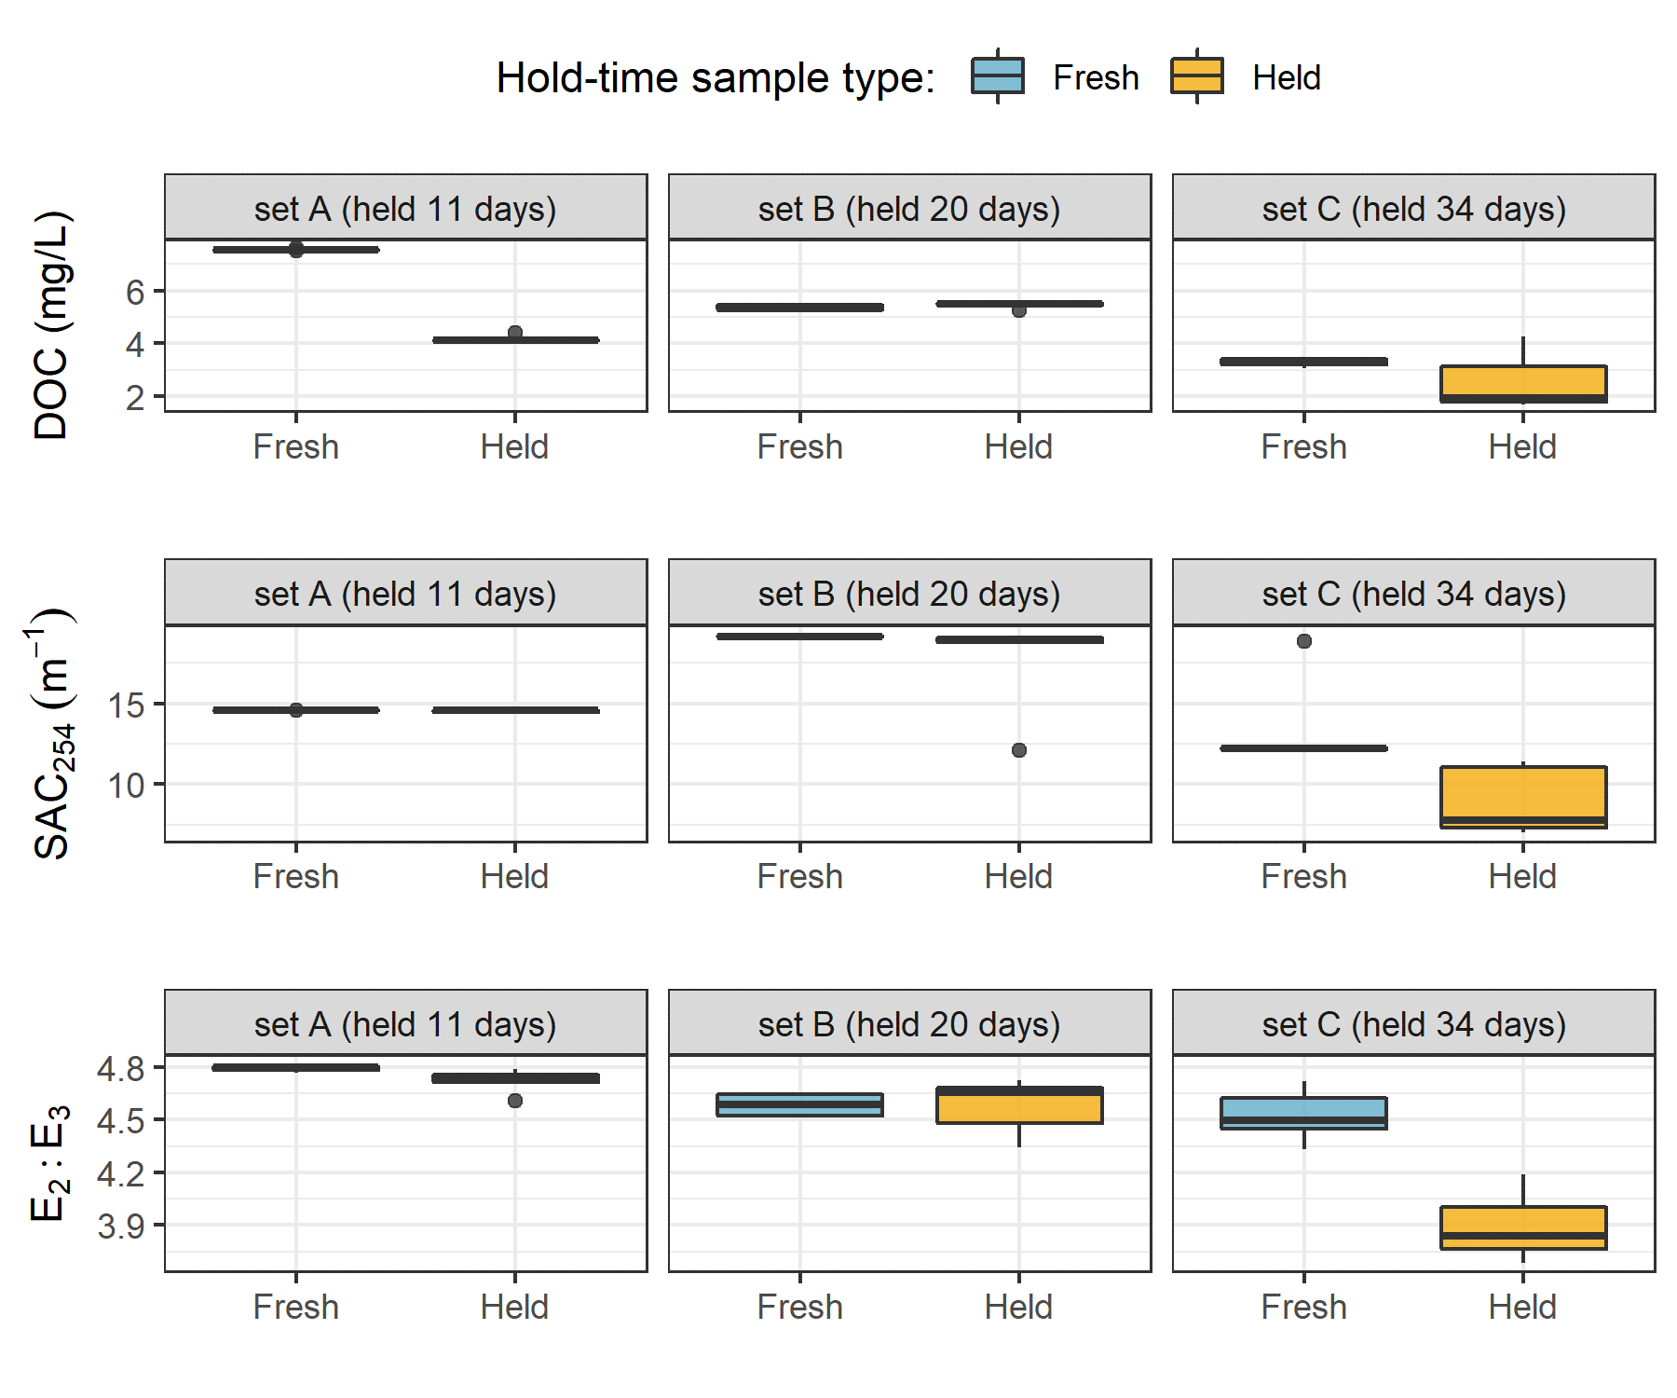
Rack Sample Hold-time Experiments
Set A:
DOC concentration changed (90% confidence, p = 0.063)
Set B:
No changes to NOM quantity or quality
Set C:
significant changes to SAC₂₅₄ and E₂:E₃ (p = 0.0625)

Slide 33
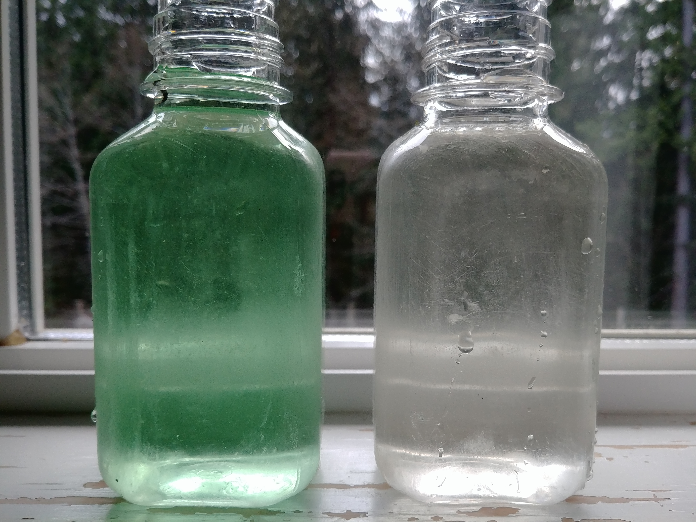
Assumption Validation
Discrete sample collection test:
A sample of colourless water was collected with siphon sampler bottle in a bucket
Food colouring was added to the bucket water with flow (hose)
The sample bottle remained submerged for 15 minutes in moving green water
The bottle was removed and collected sample was compared to the surrounding water
Result: There was no exchange between surrounding water and sample contained in the siphon sampler bottle
Surrounding Water
Collected Water

Slide 34
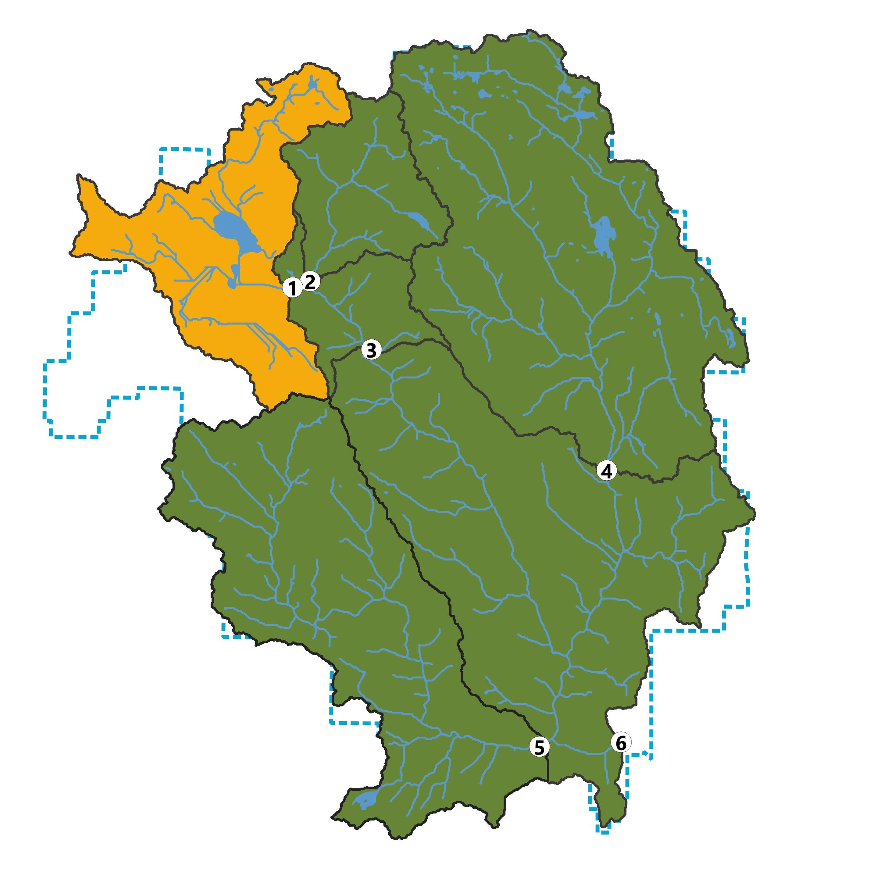
Weeks crk

Slide 35
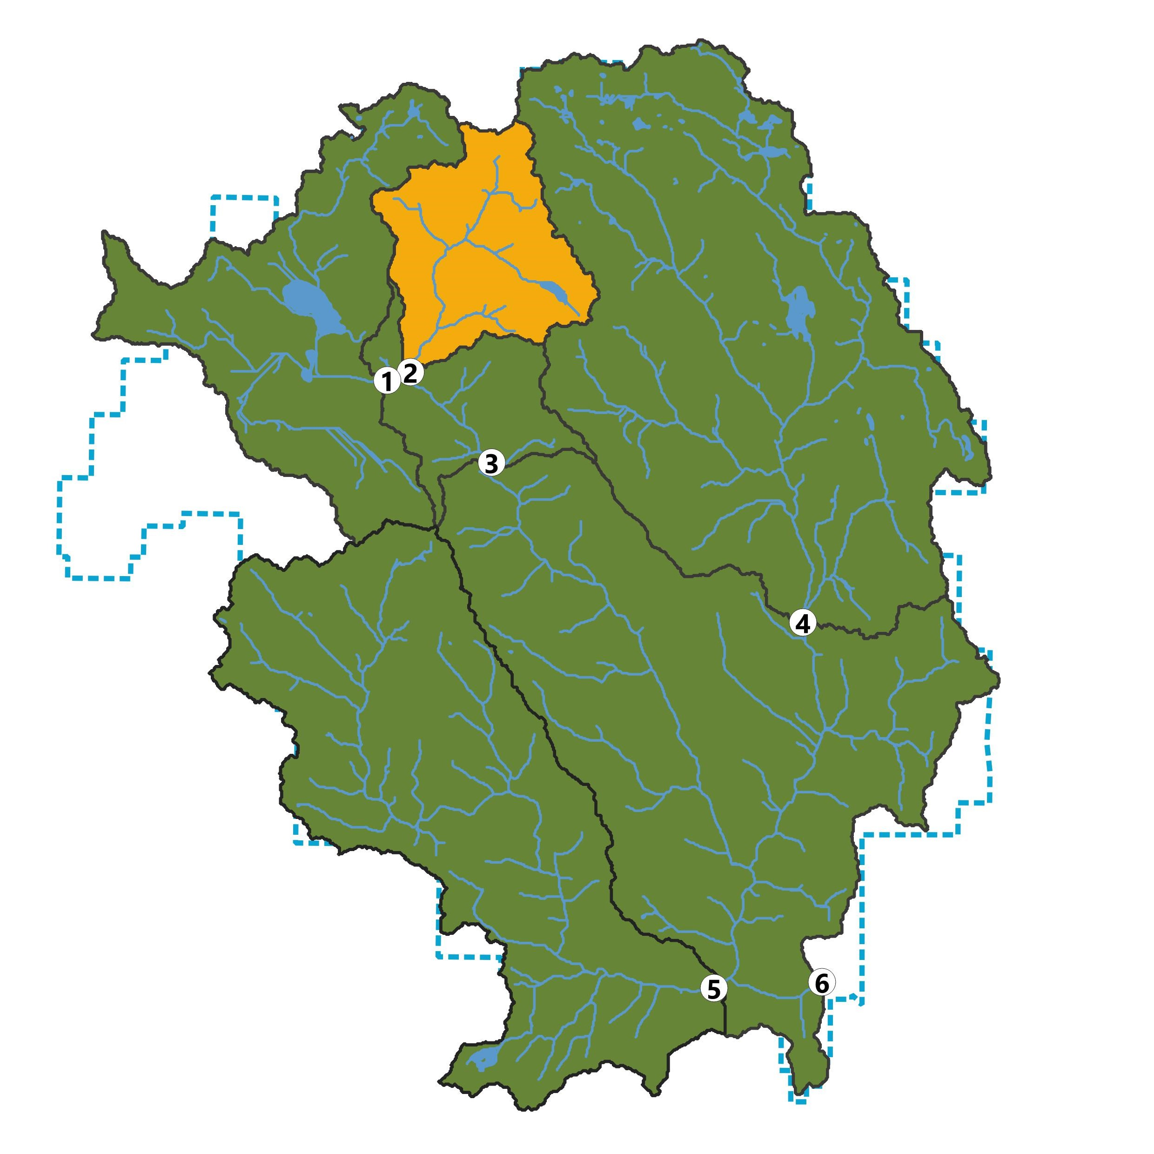
Chris crk

Slide 36
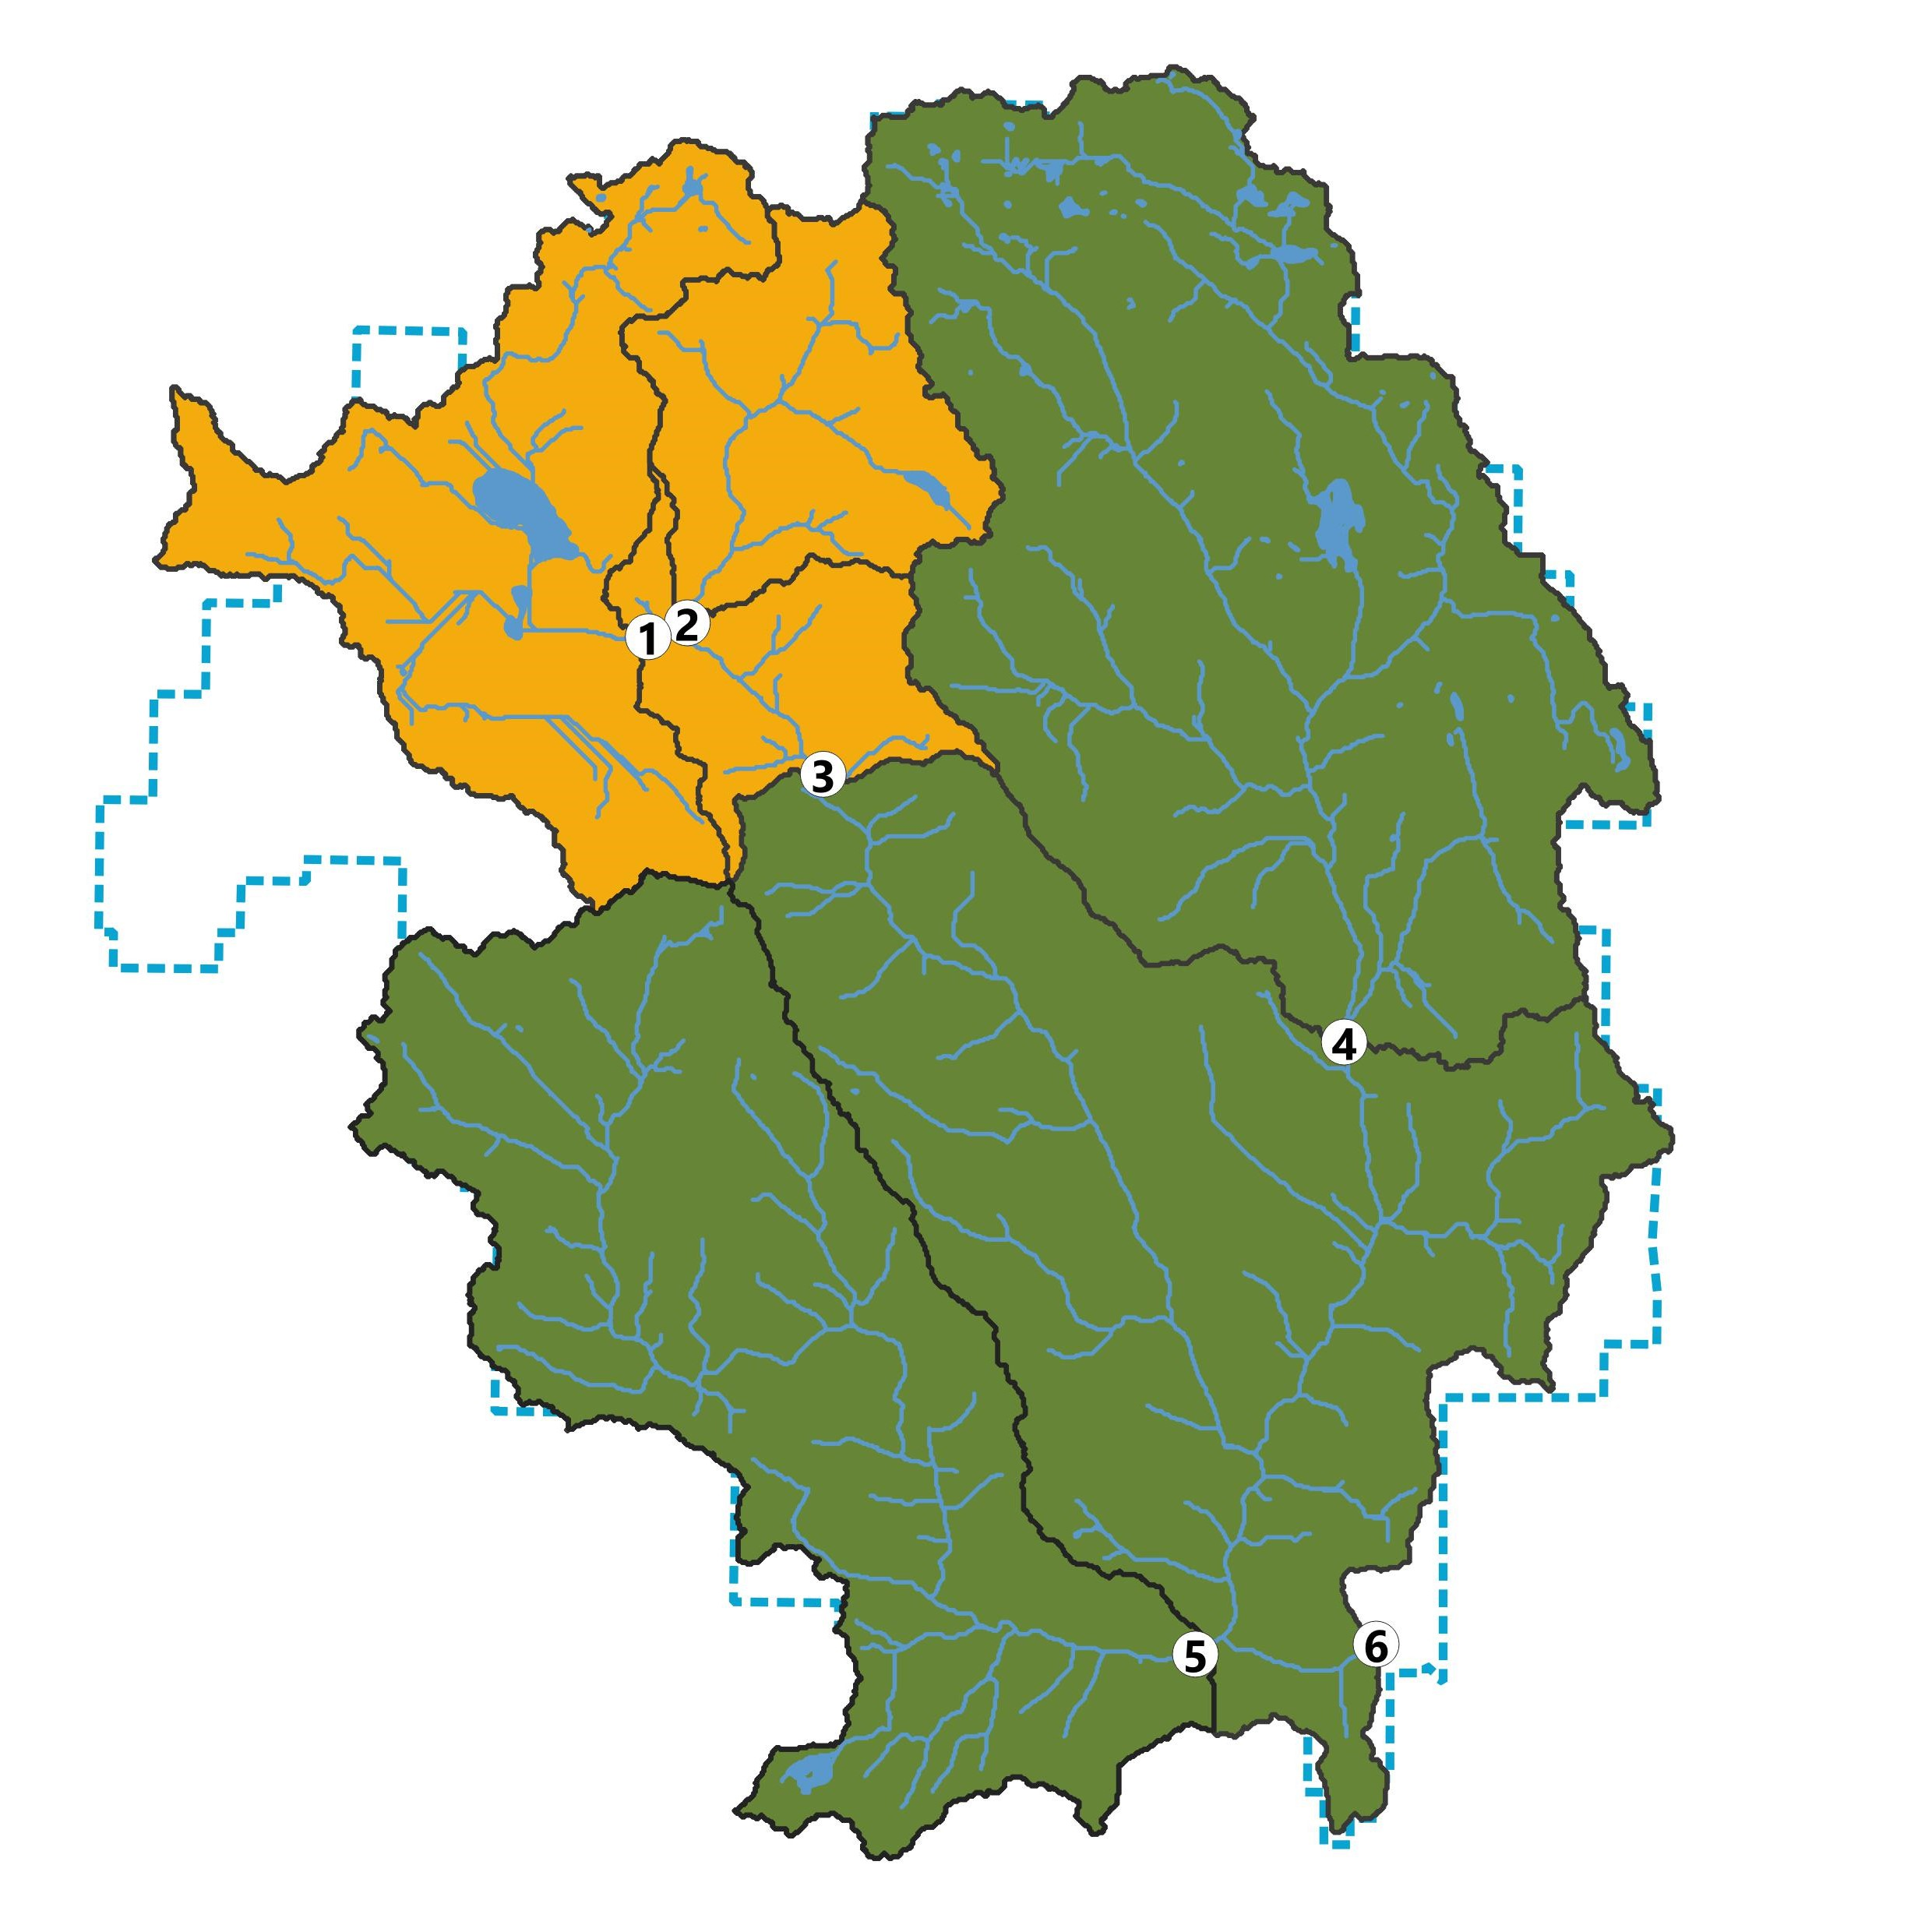
Leech Head

Slide 37
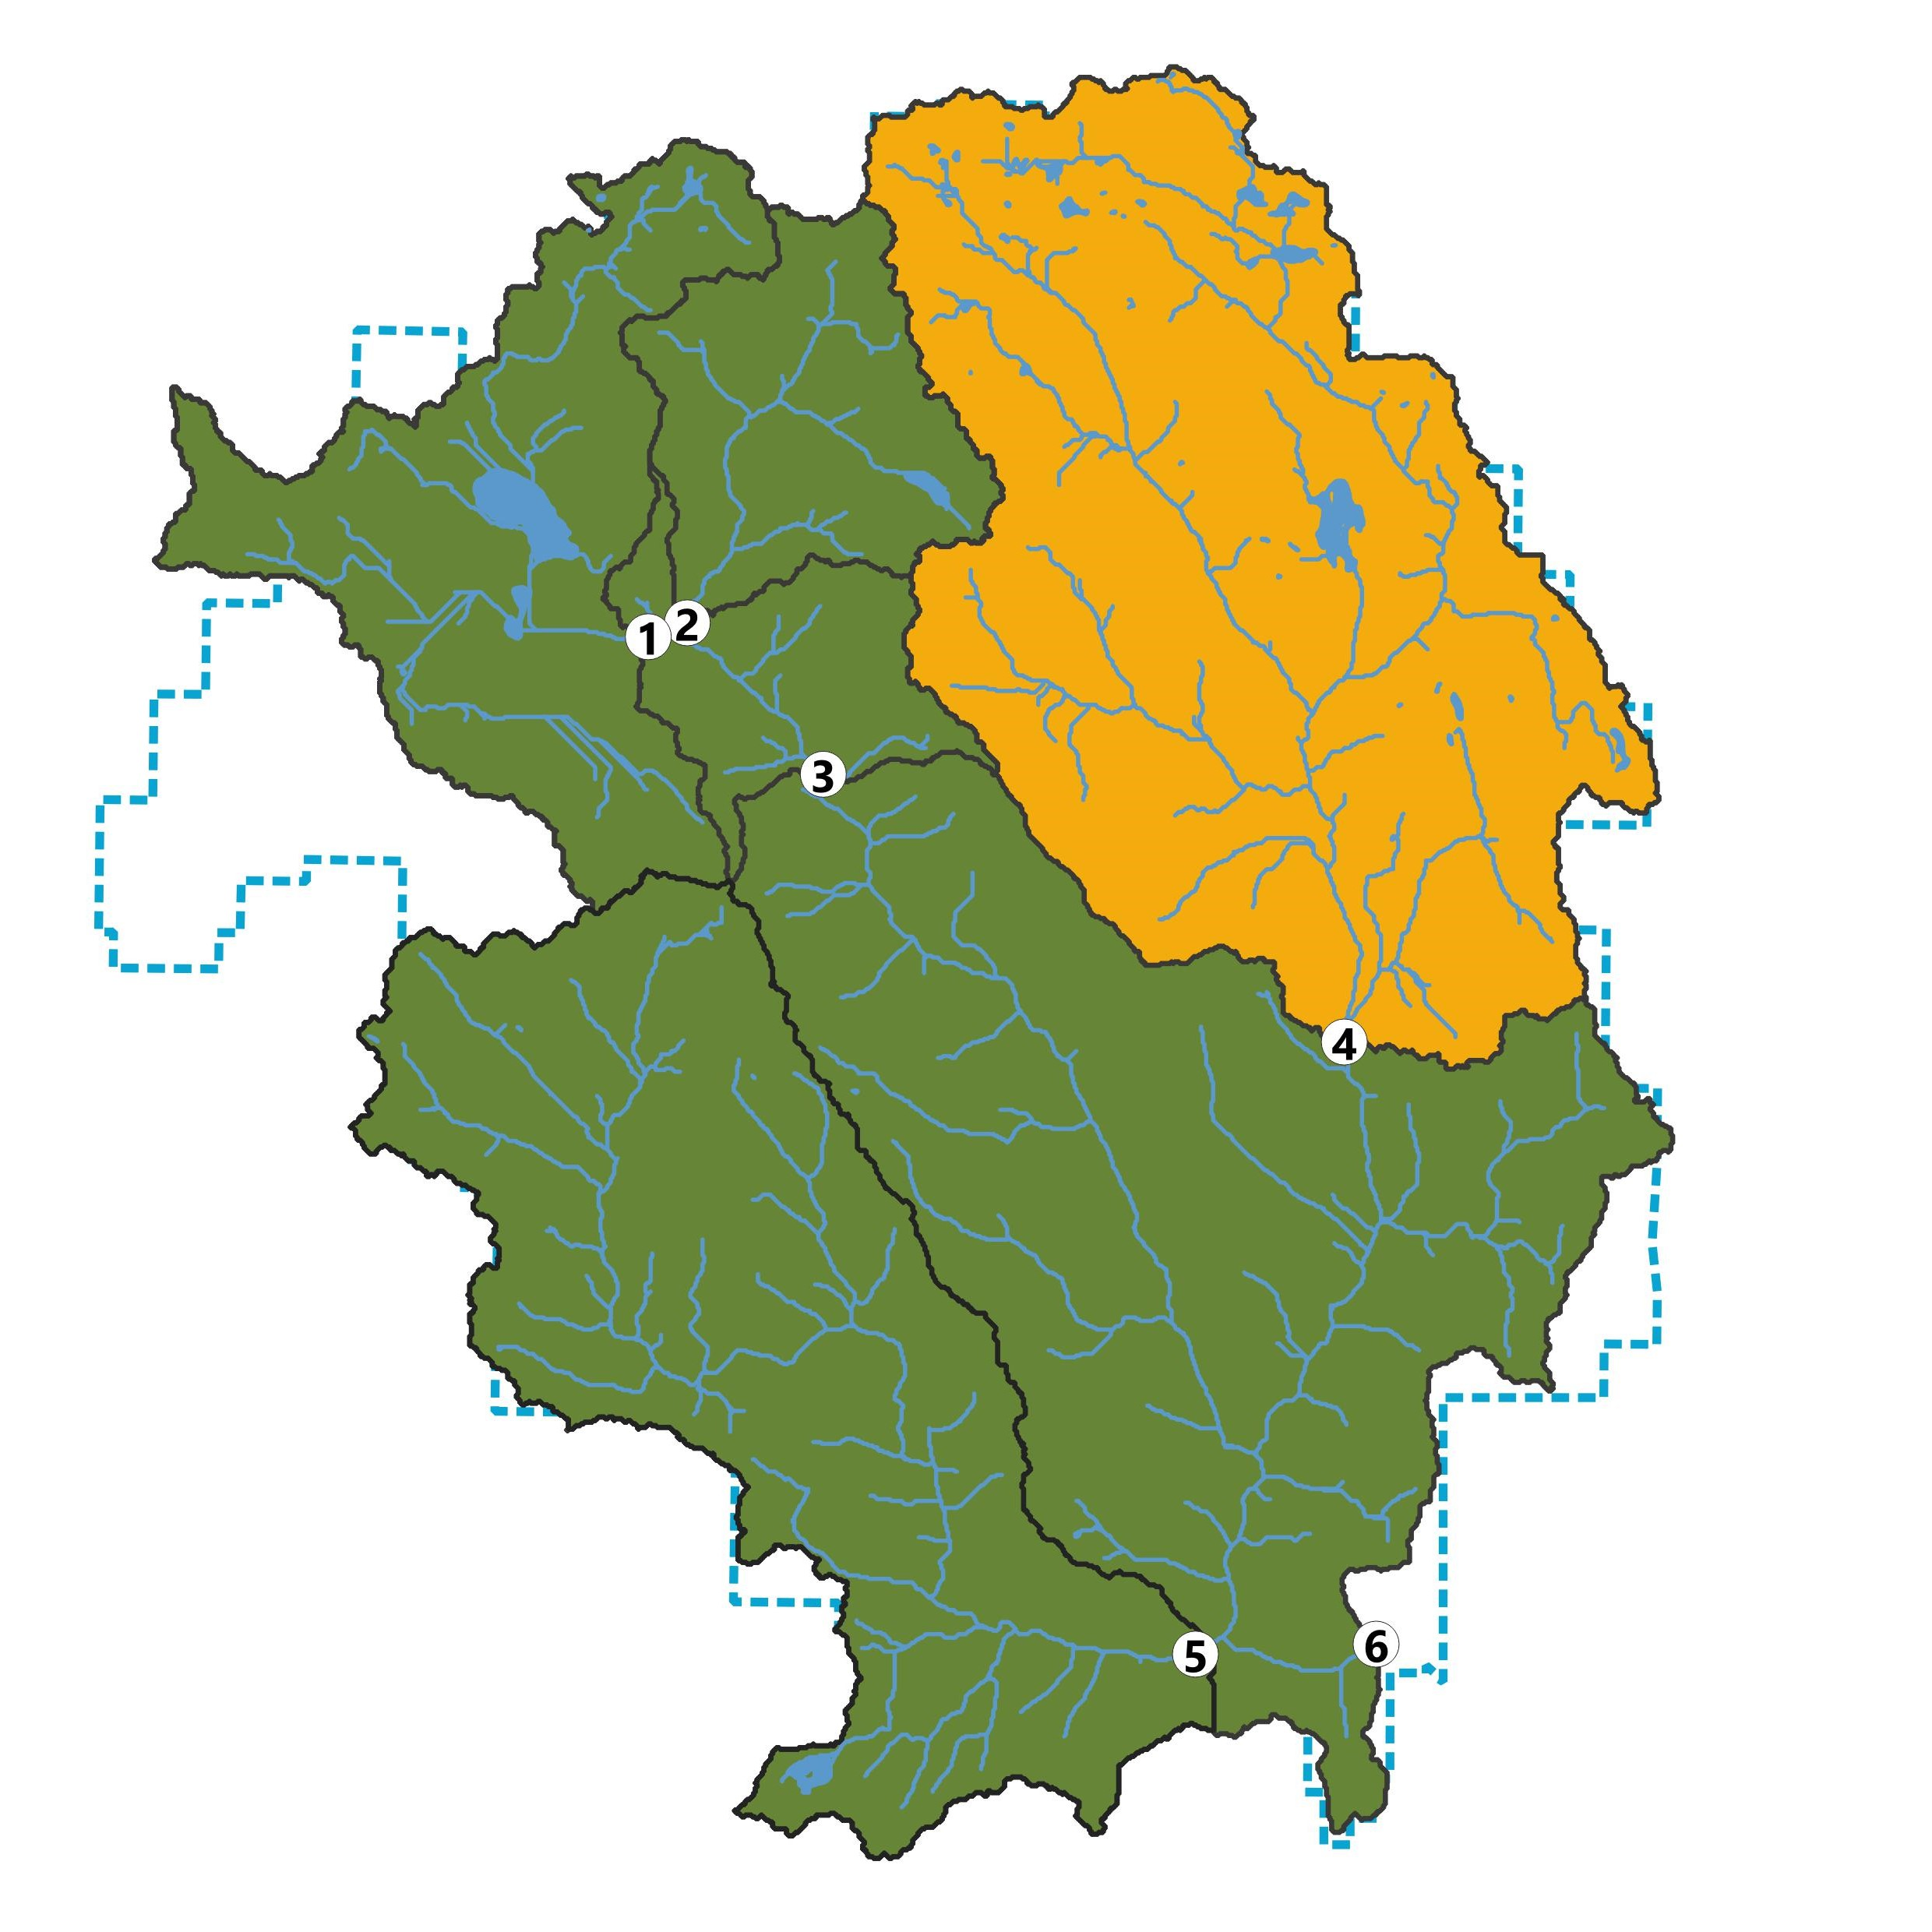
Cragg Creek

Slide 38
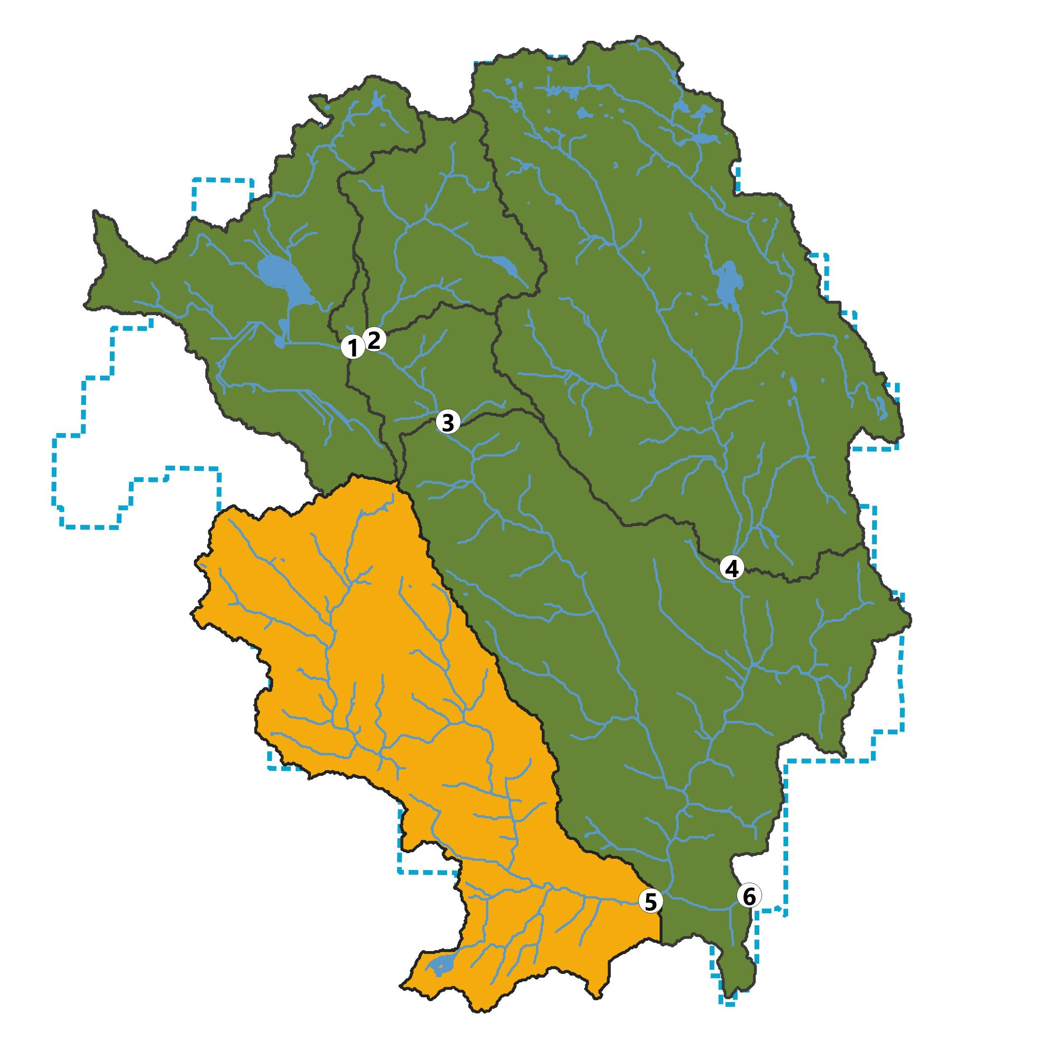
West Leech

Slide 39
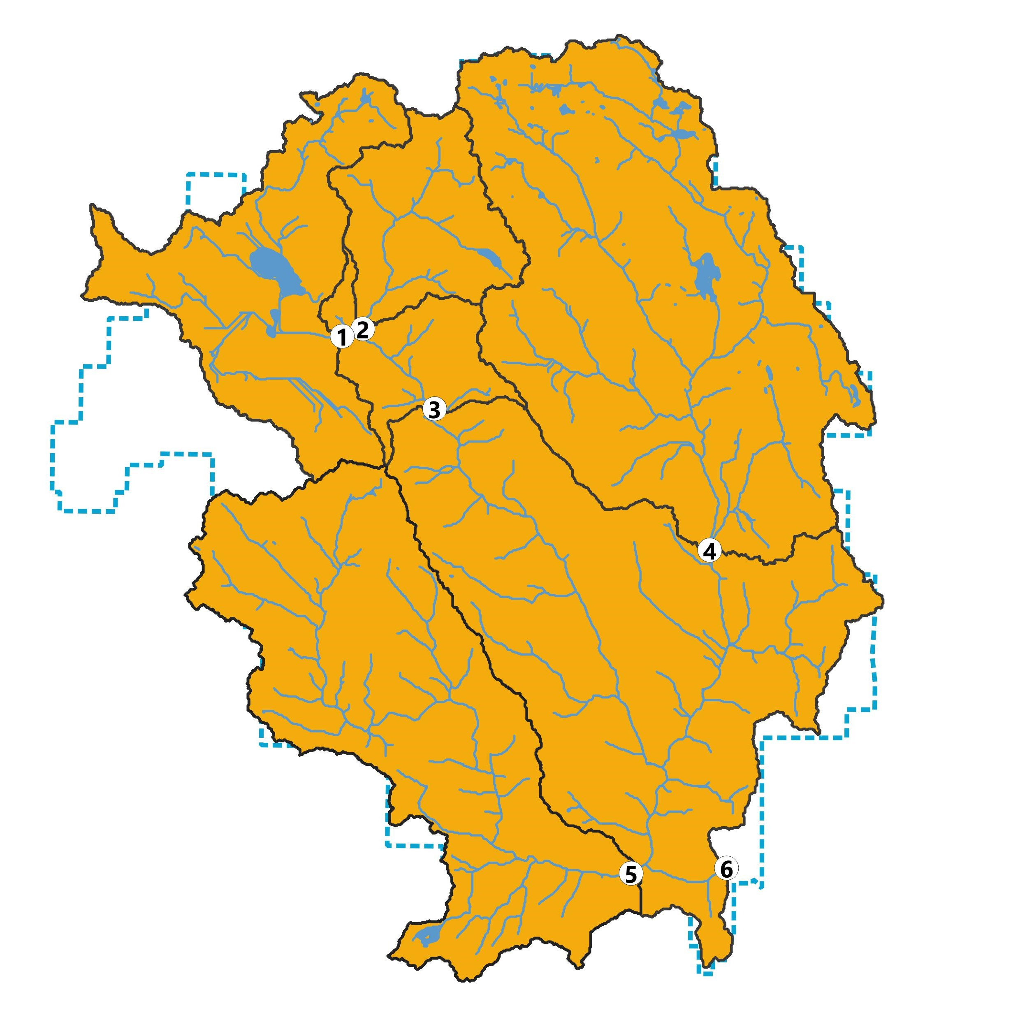
Leech Tunnel

